Slide 1
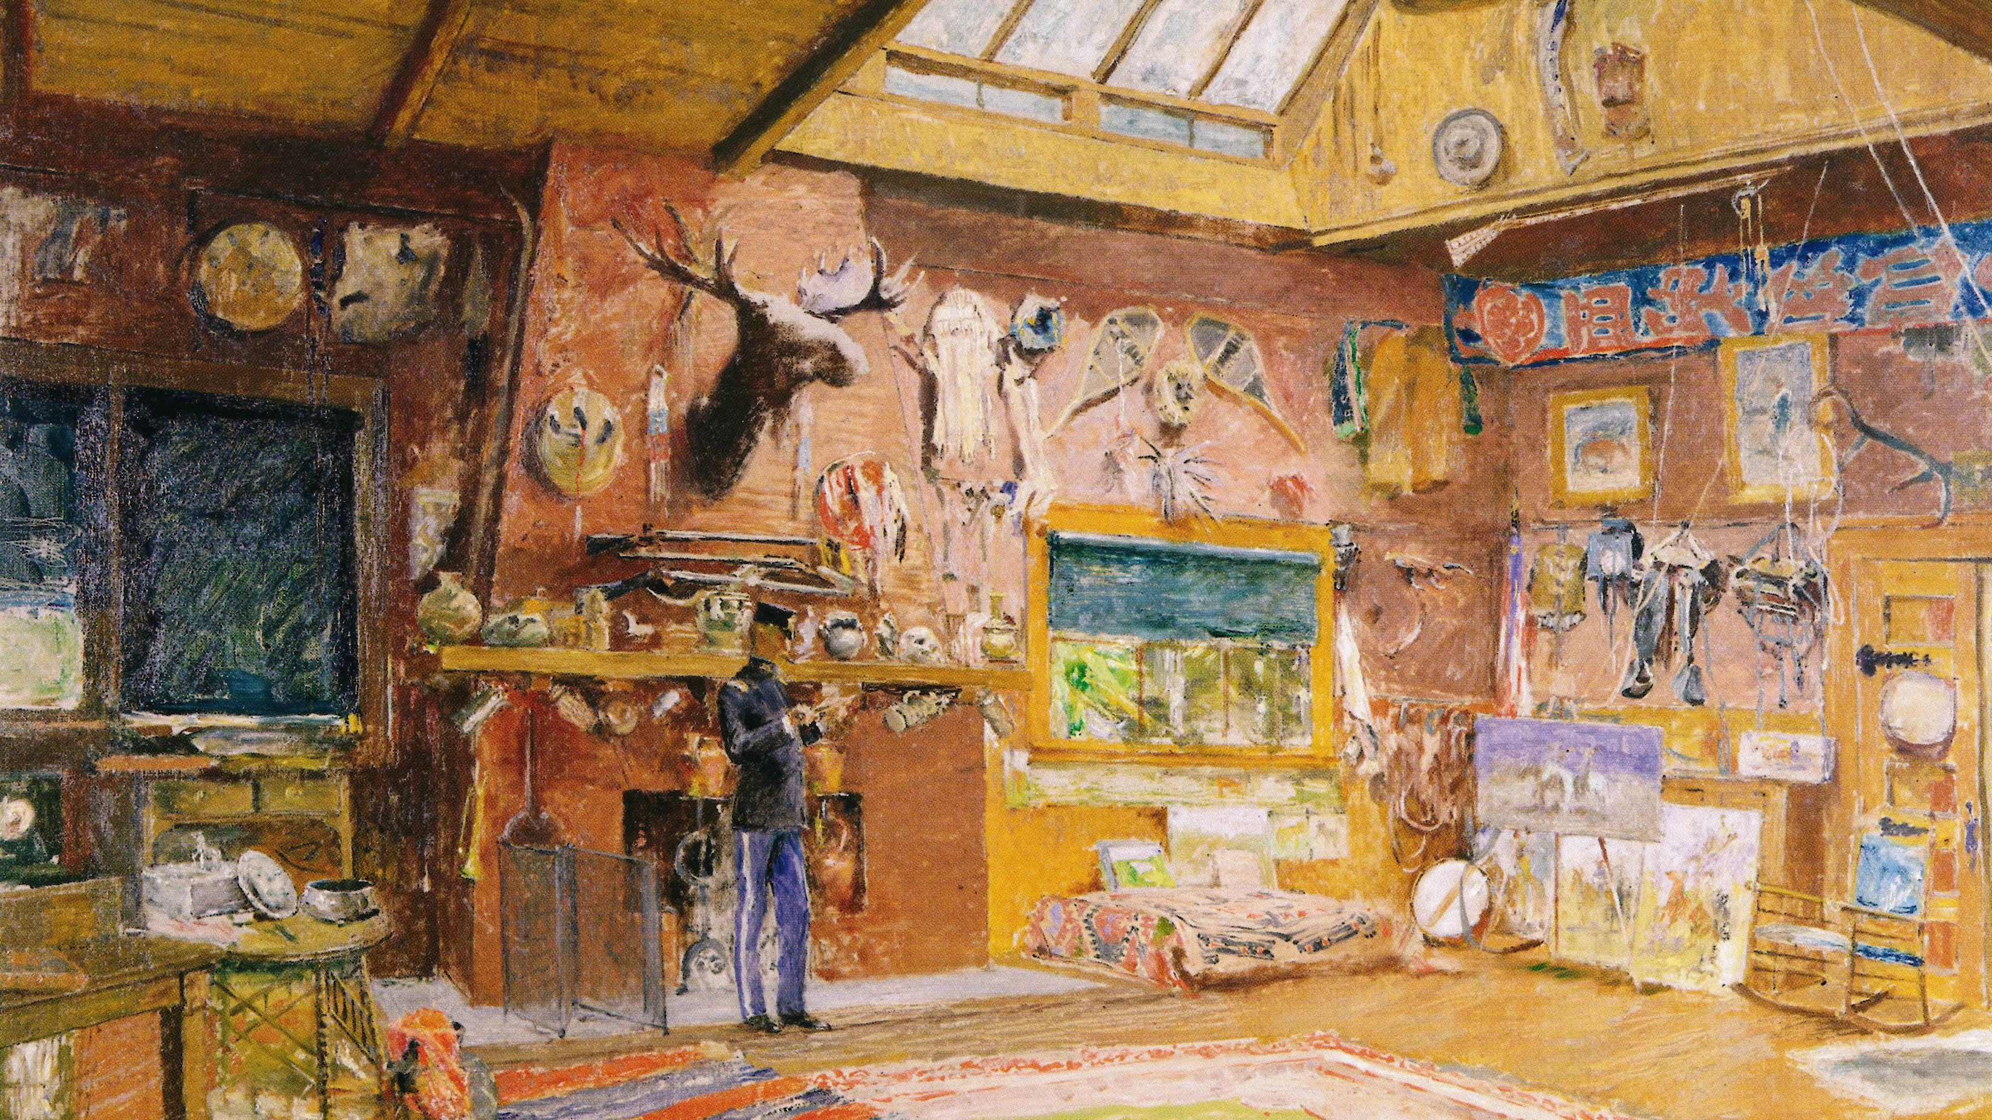
Frederic Remington’s Studio Collection:
Something of a Museum of the Old West
Karen B. McWhorter
Scarlett Curator of Western American Art
Whitney Western Art Museum

Slide 2
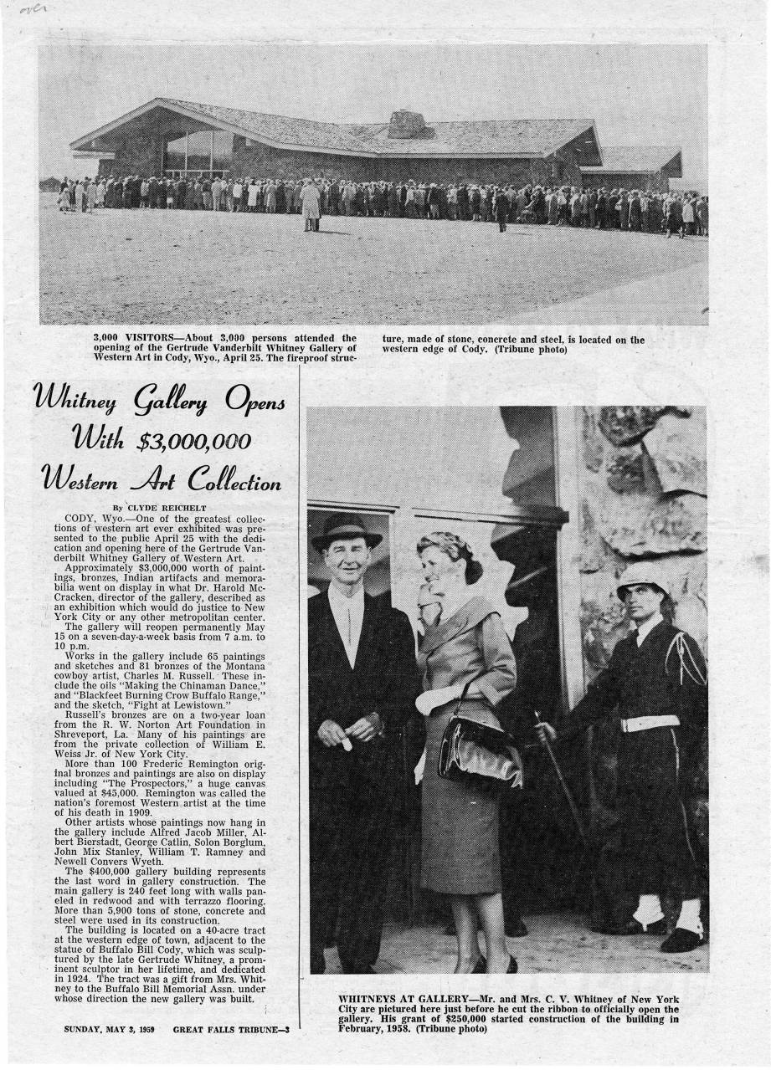
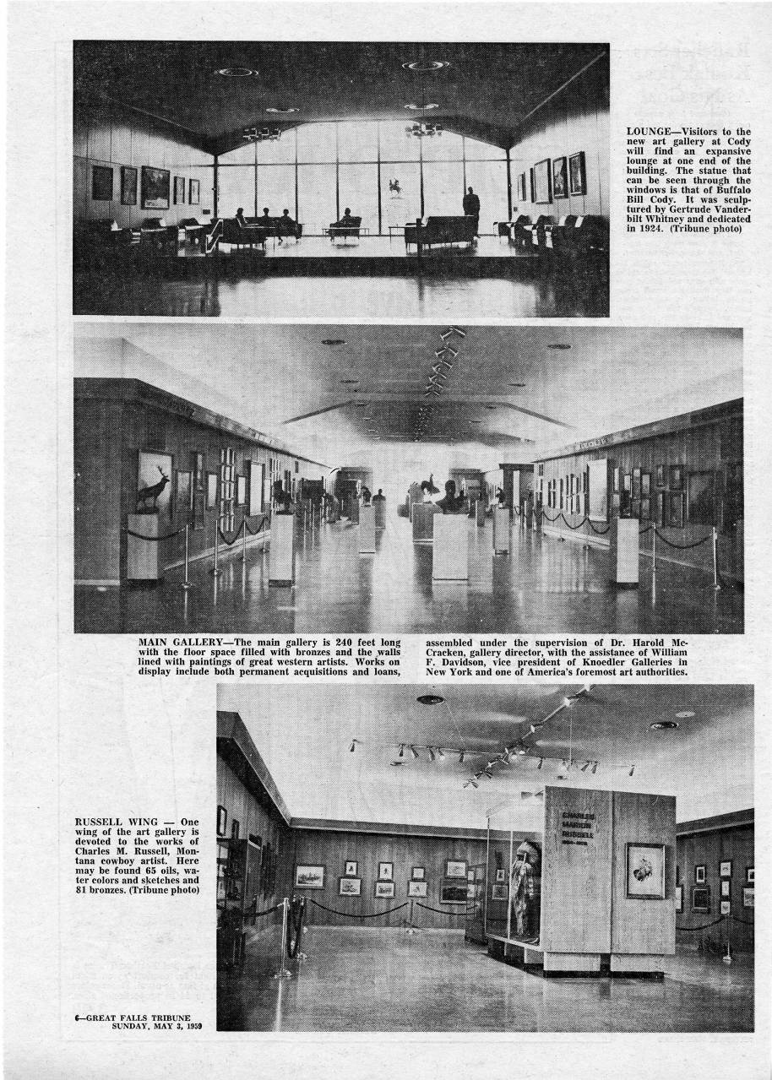

Slide 3
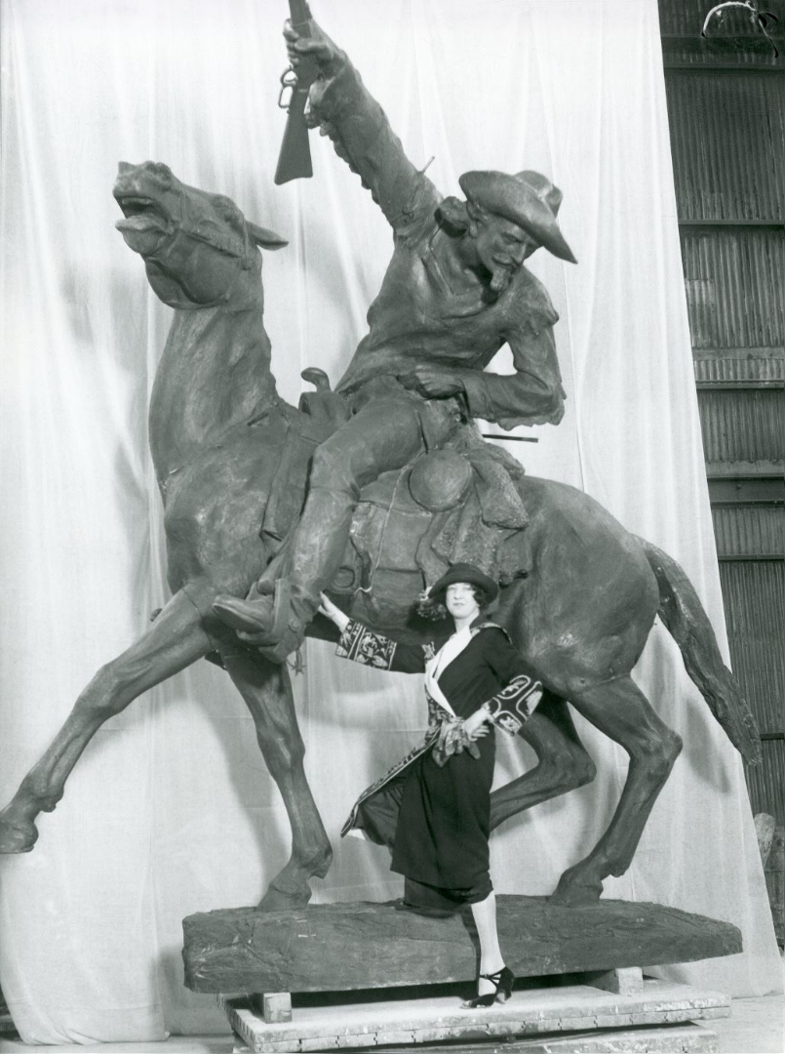
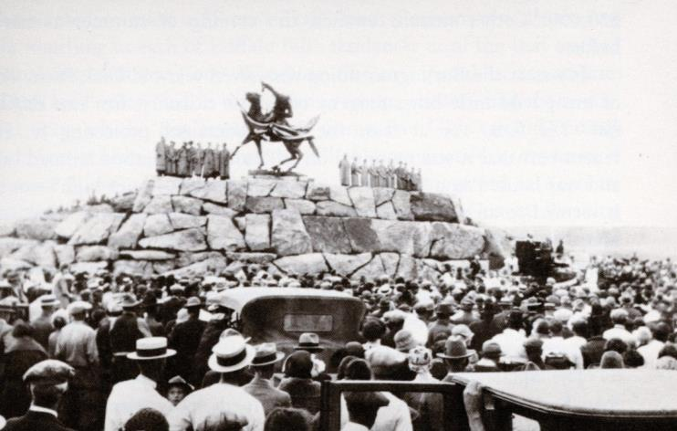
The unveiling, July 4, 1924
Gertrude Vanderbilt Whitney with her finished sculpture,
Buffalo Bill – The Scout, 1924

Slide 4
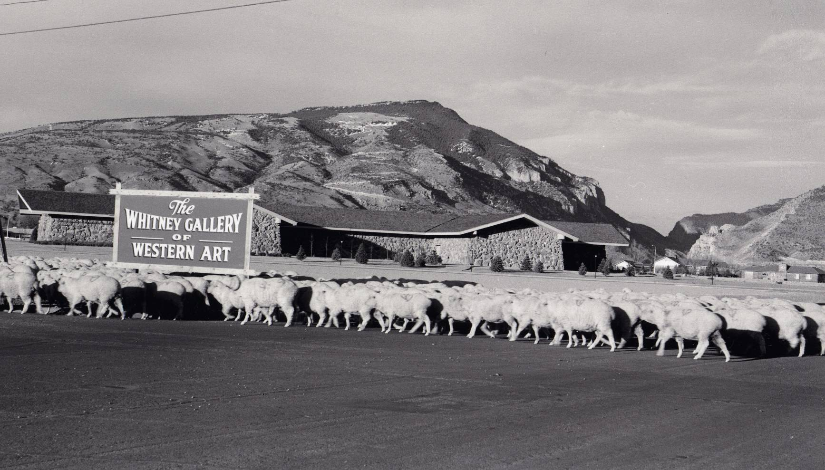
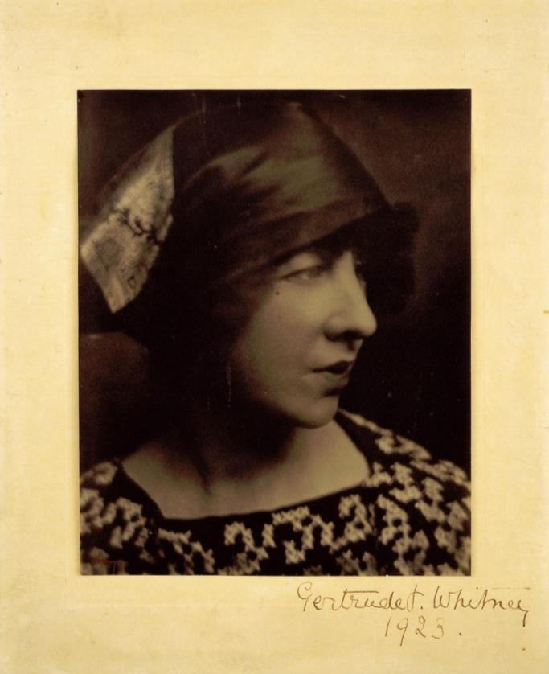
The Whitney Gallery of Western Art, c. 1959
The Whitney’s namesake,
Gertrude Vanderbilt Whitney (1875 -1942)

Slide 5
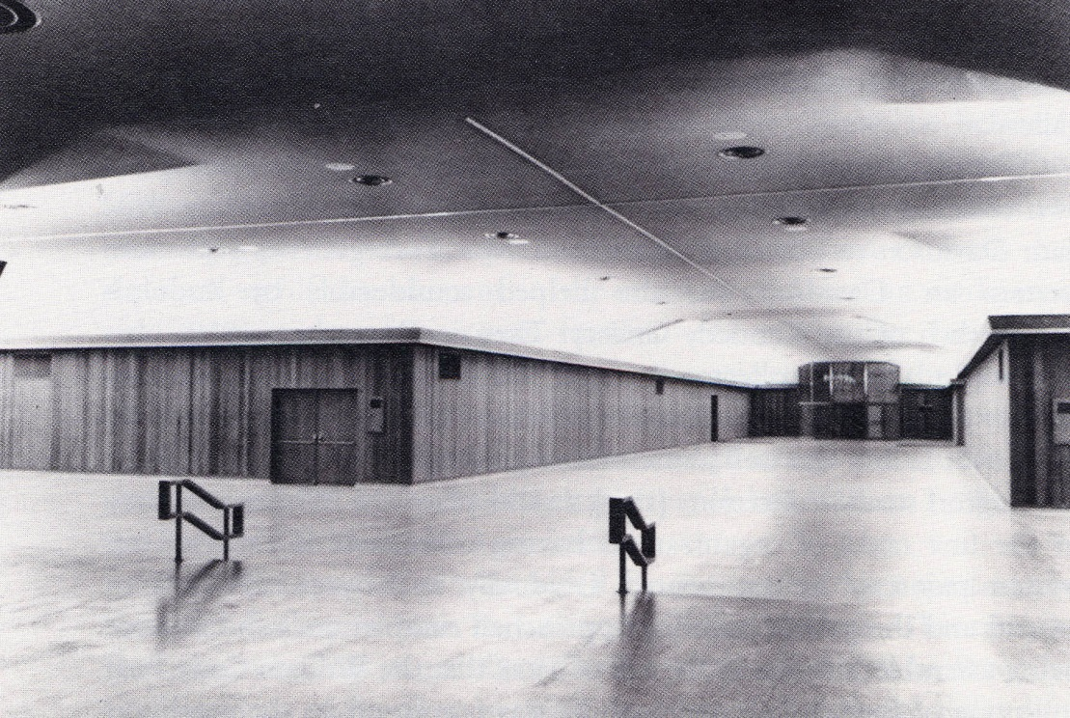

Slide 6
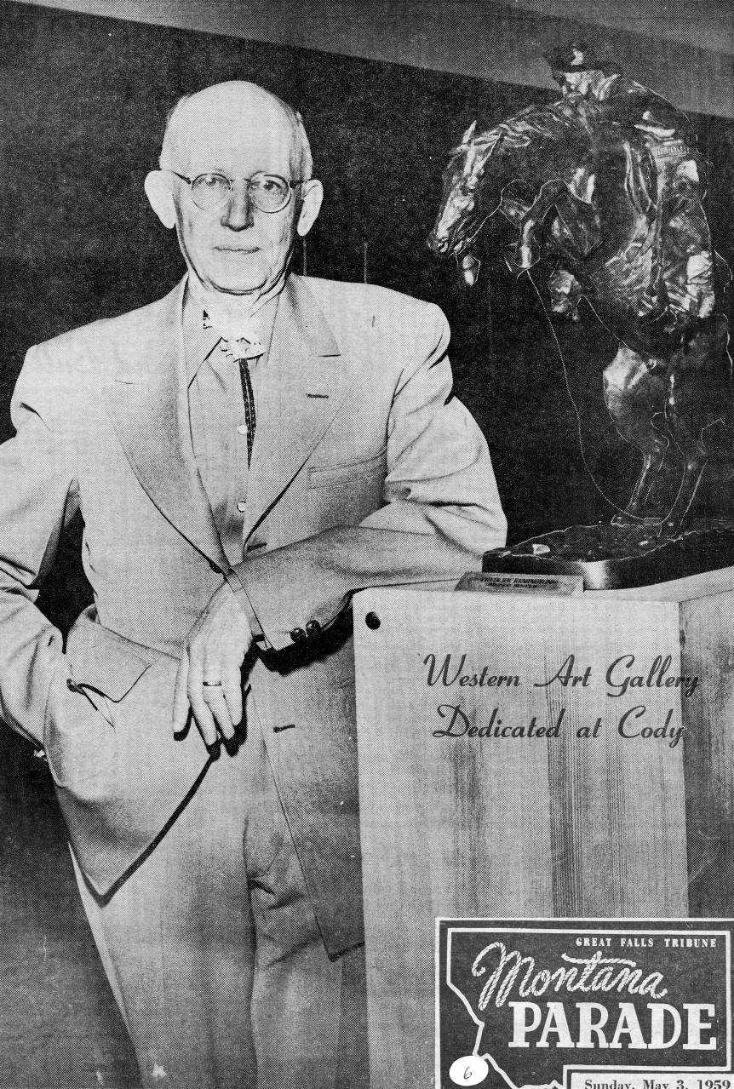
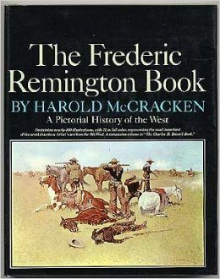
Dr. Harold McCracken, director,
Whitney Gallery of Western Art

Slide 7
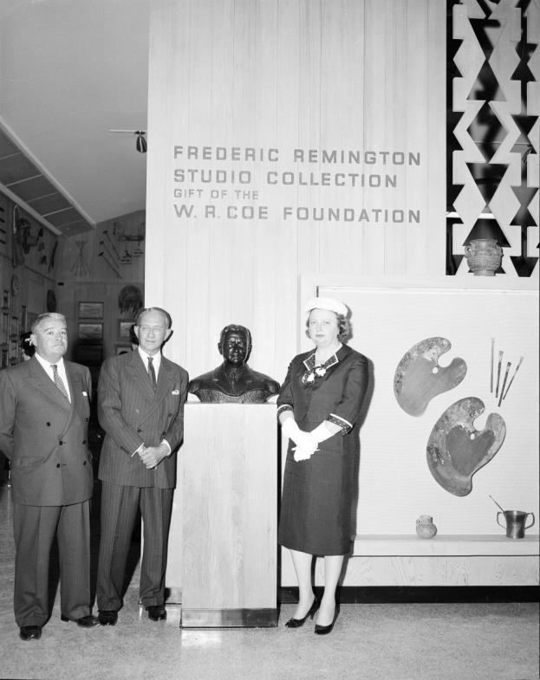
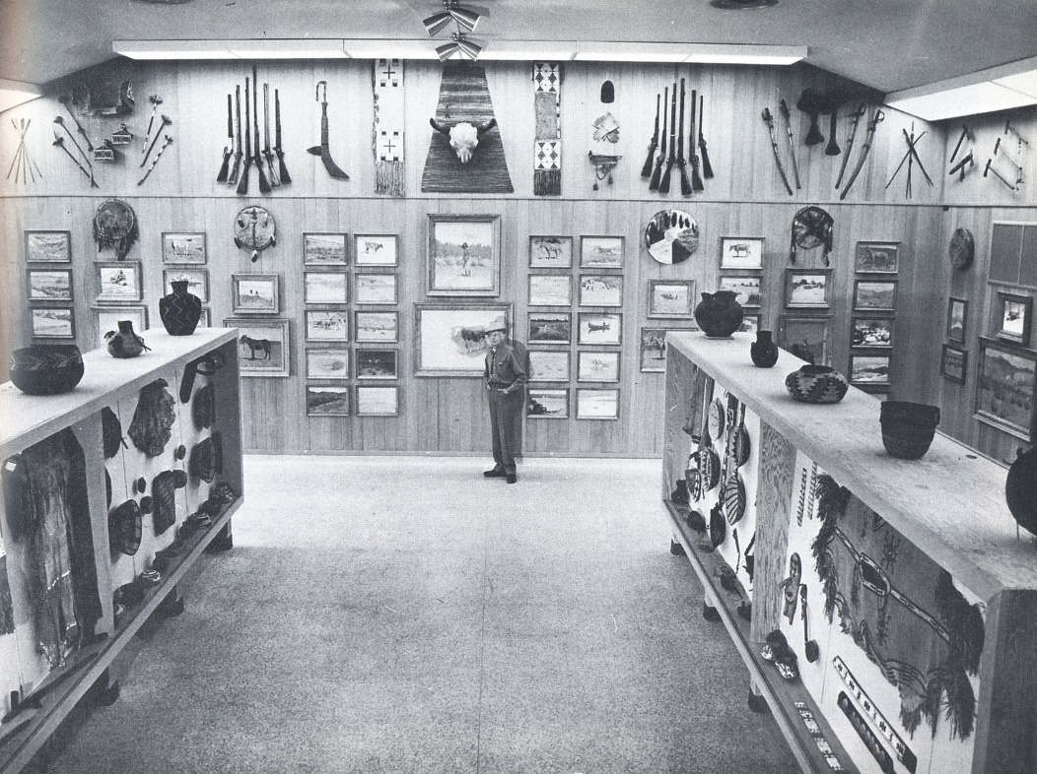
McCracken; Remington Studio Collection installed, 1959

Slide 8
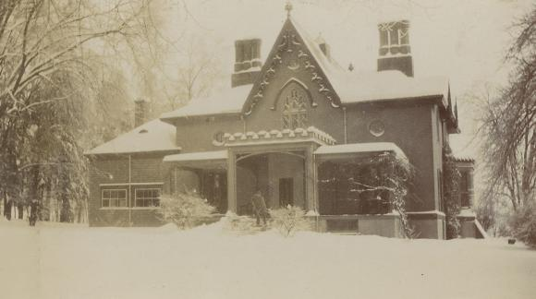
“Endion” (Algonquin for “The Place Where I Live”)
Eva and Frederic Remington’s home, 301 Webster Avenue, New Rochelle, NY

Slide 9
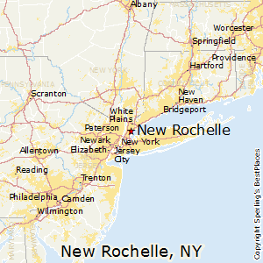
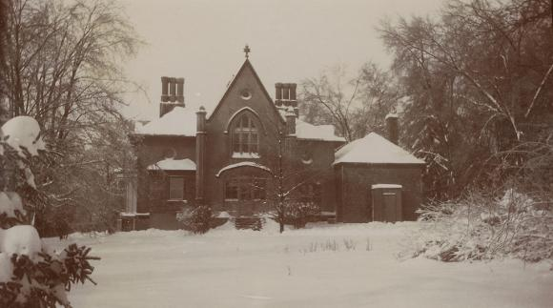
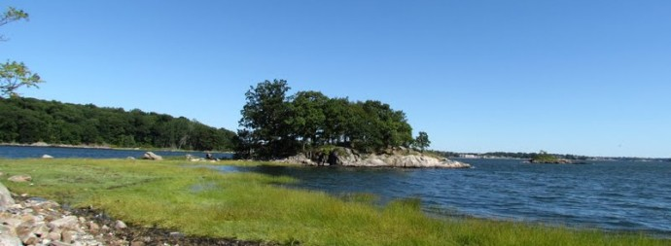

Slide 10
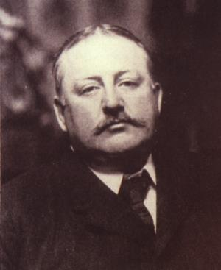
Remington, to friend Owen Wister:
“[I] have concluded to build a butler’s pantry and a studio (Czar size) on my house—we will be torn (up) for a month and then will ask you to come over—throw your eye on the march of improvement and say this is a great thing for American art. The fireplace is going to be – Big – big…”

Slide 11
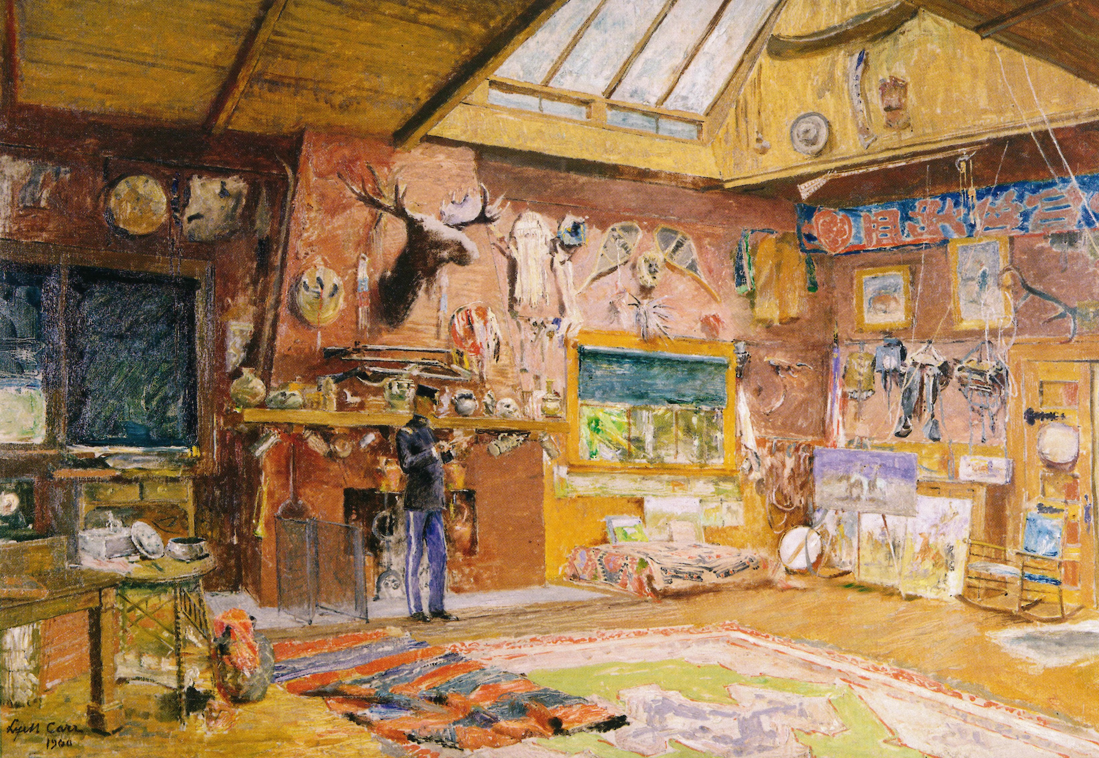

Slide 12
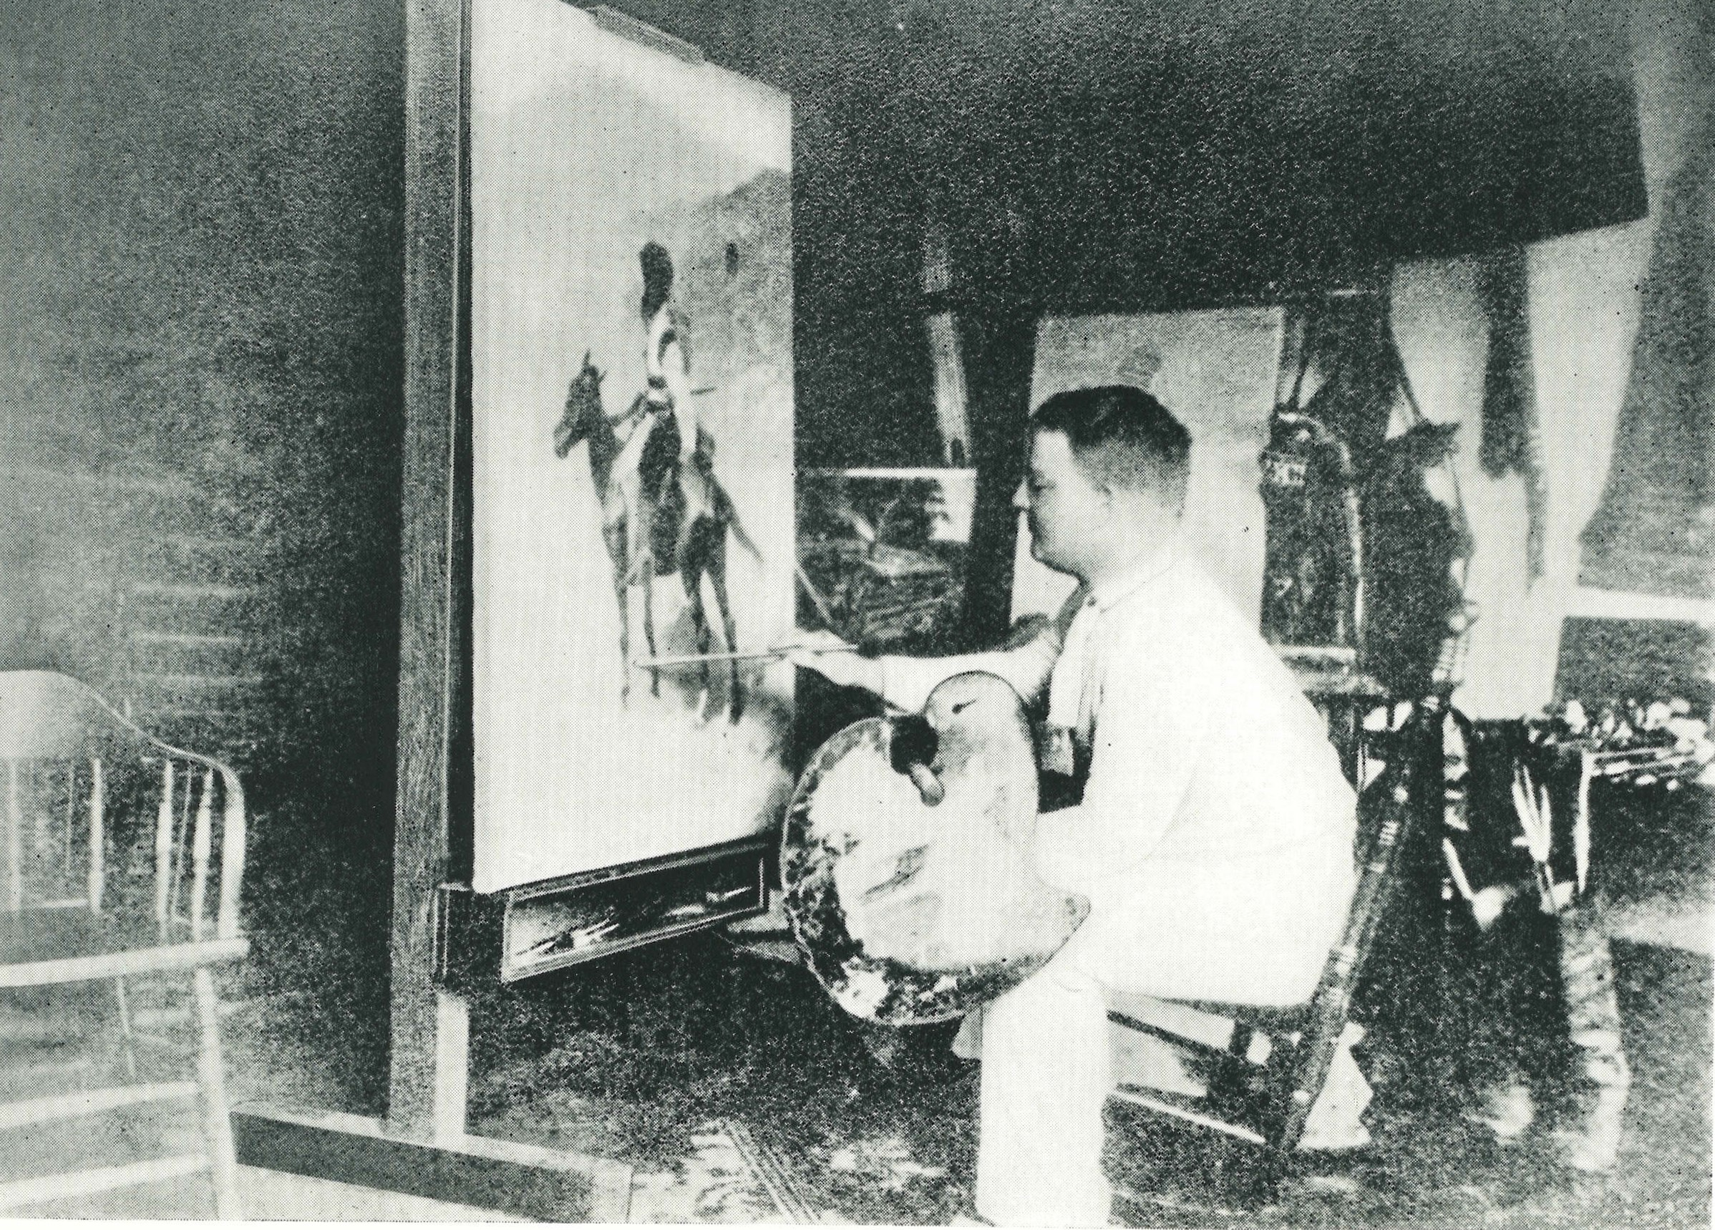
Remington painting The French Trapper in his Manhattan studio, 1888

Slide 13
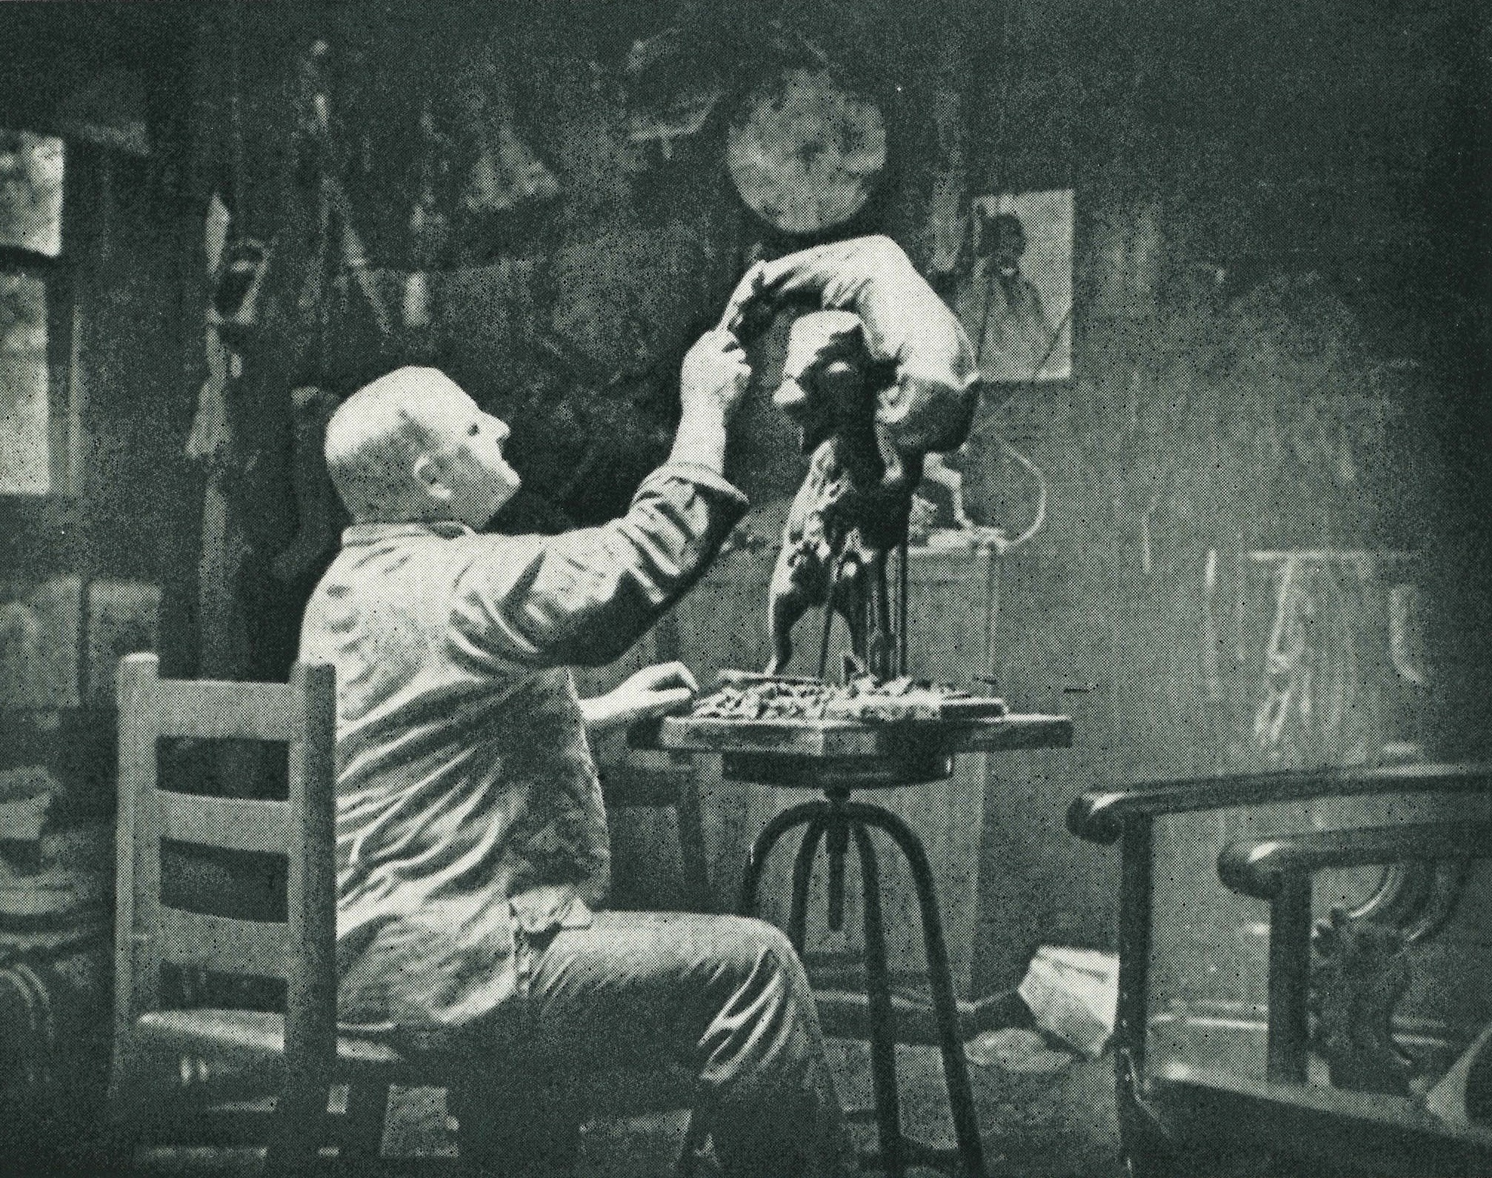
Remington working on the original clay model for the Buffalo-Horse, 1907

Slide 15
Remington working on the original clay model for the Buffalo-Horse, 1907

Slide 16
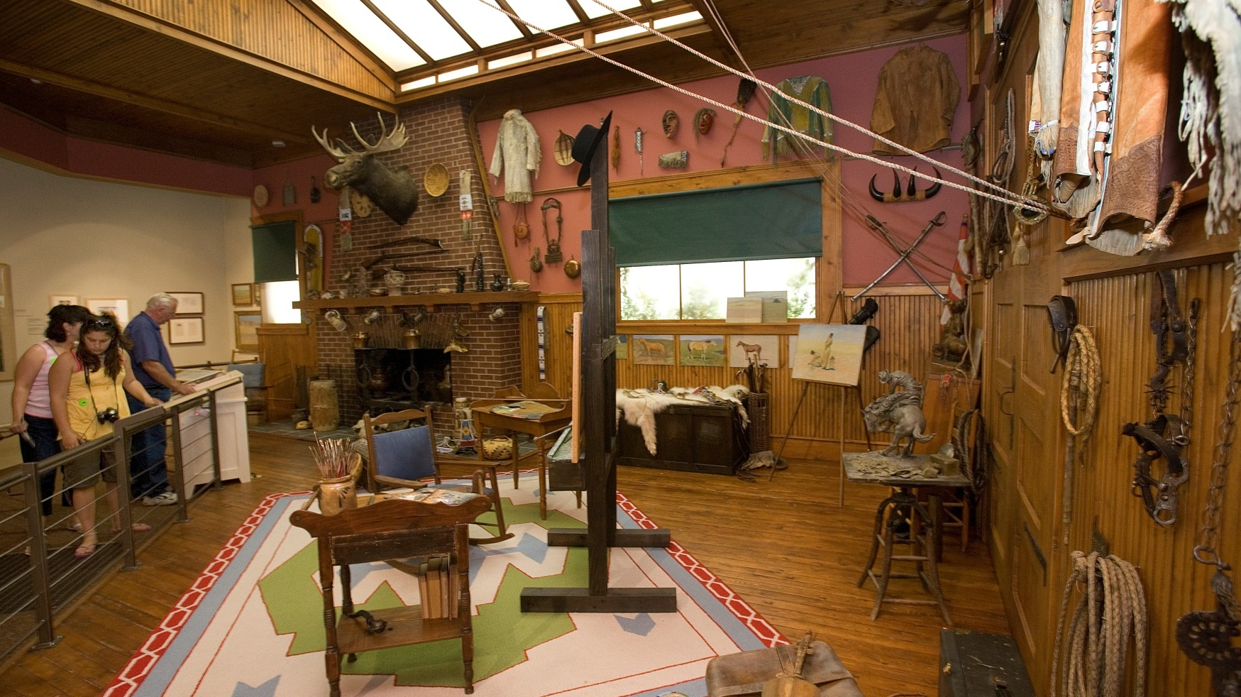

Slide 17
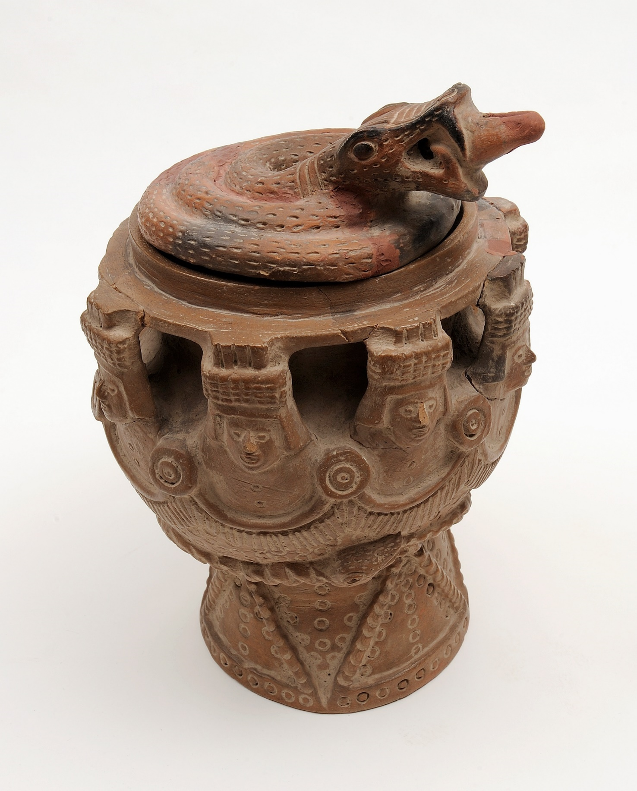
“Aztec” burial urn or Mexican pottery c. 1900. 1.67.354A/B

Slide 18
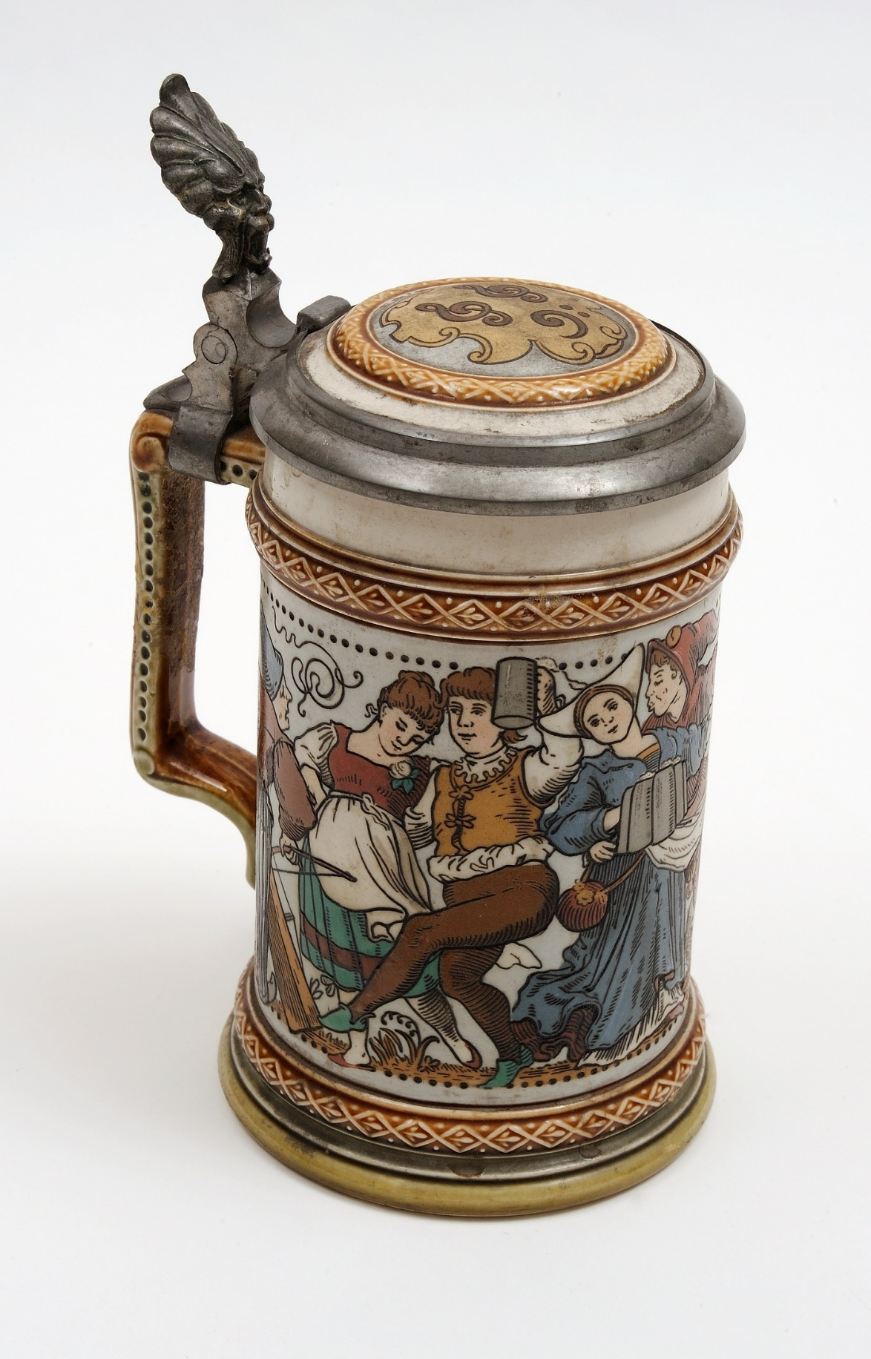
Stein, ca. 1890. Painted ceramic. 1.67.226

Slide 19
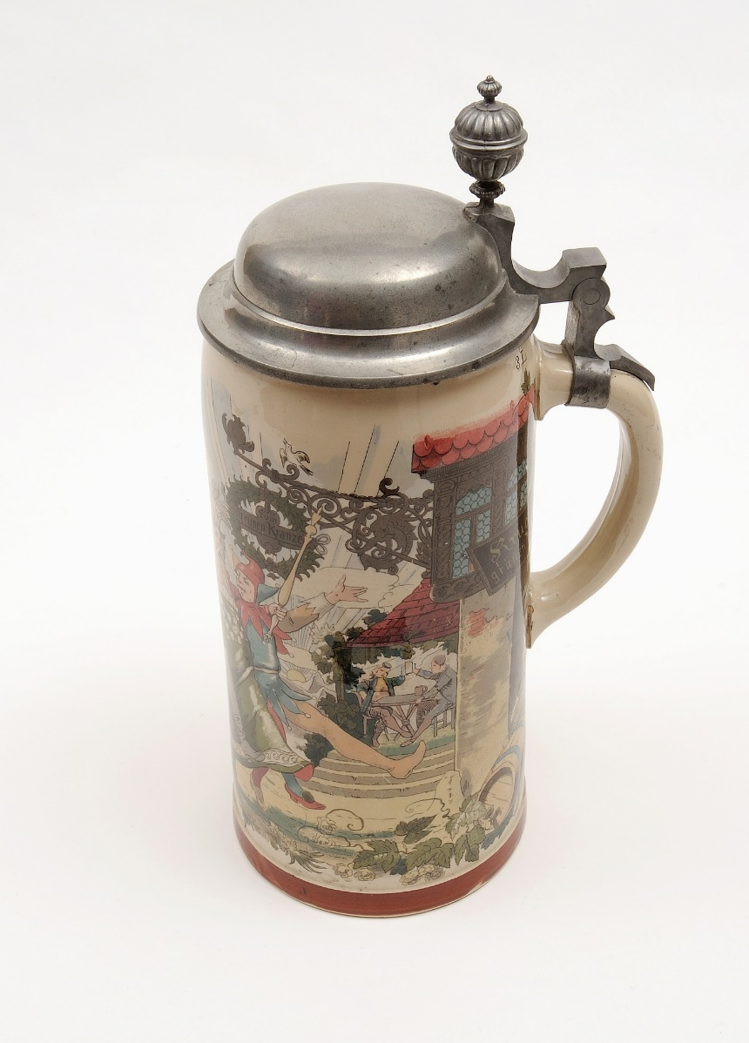
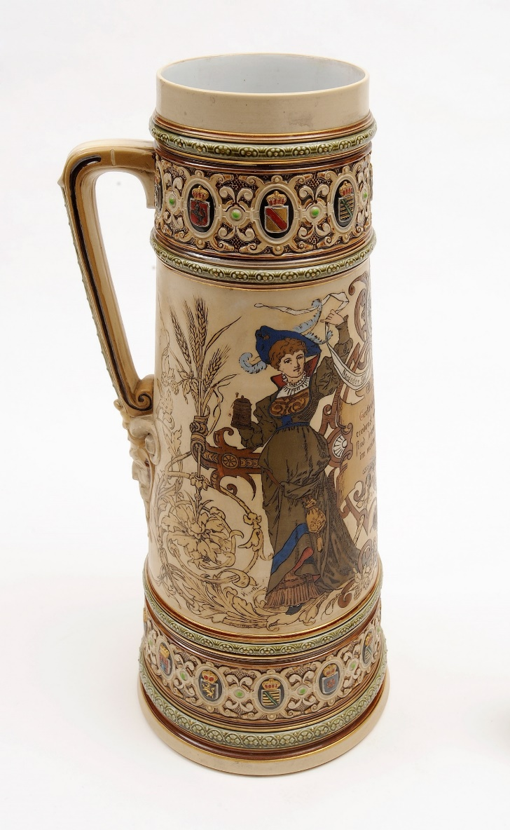
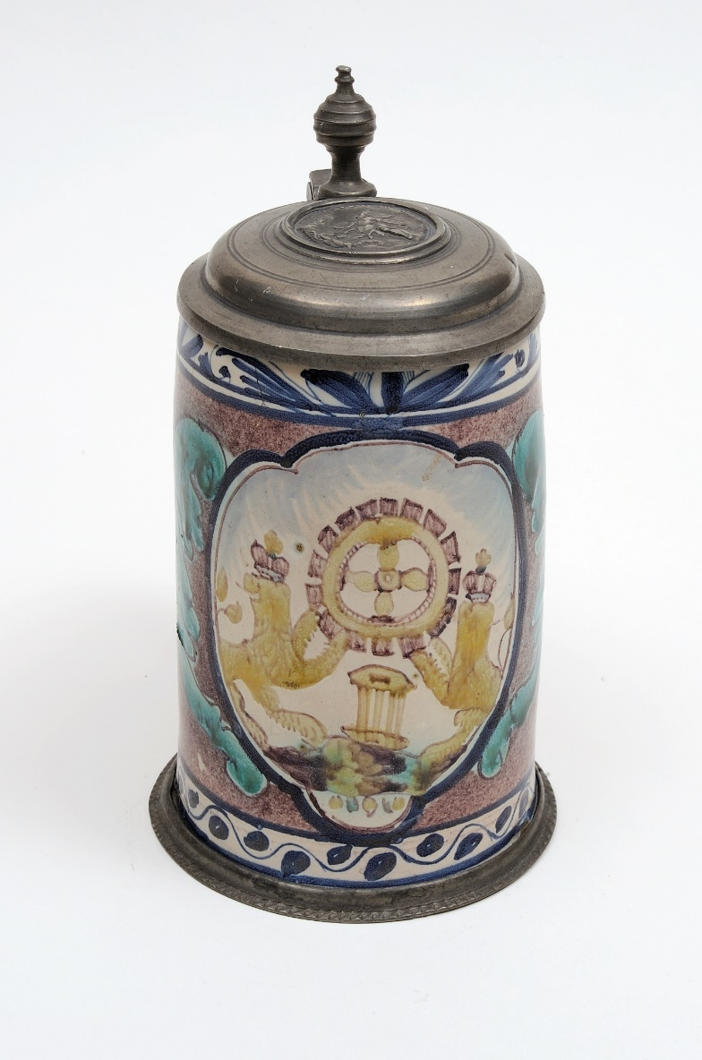
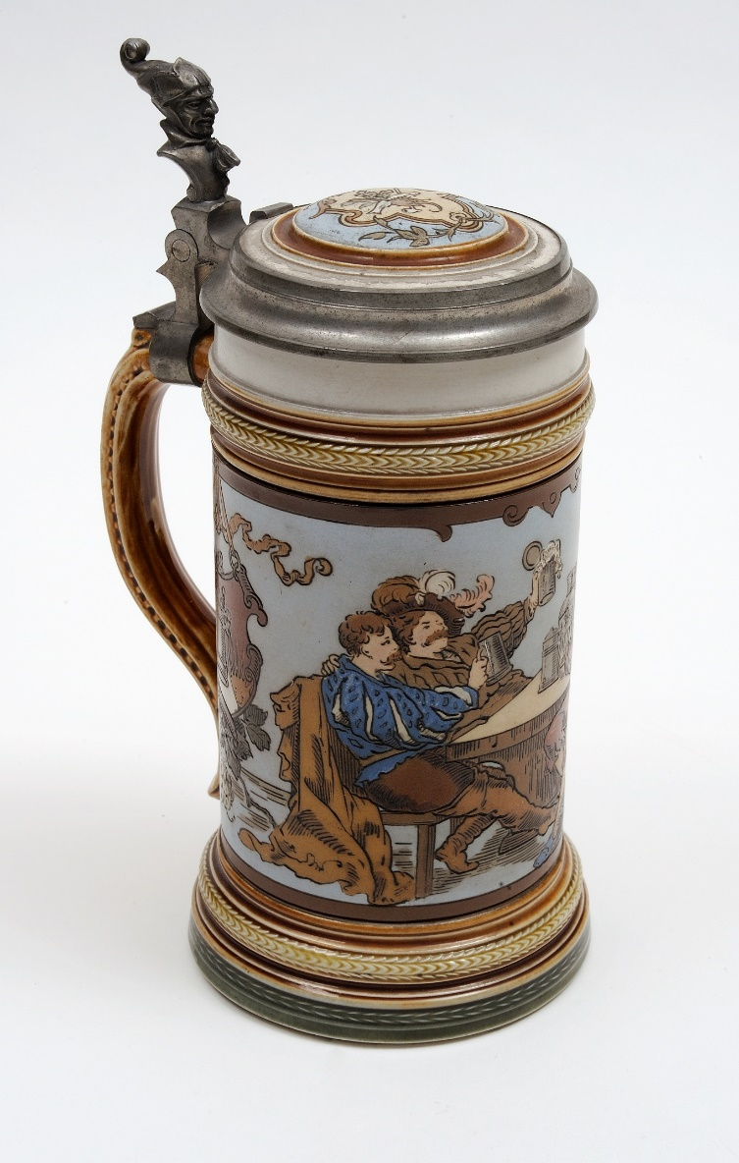
Steins, ca. 1890 and later. 1.67.224-6; .263-4

Slide 20
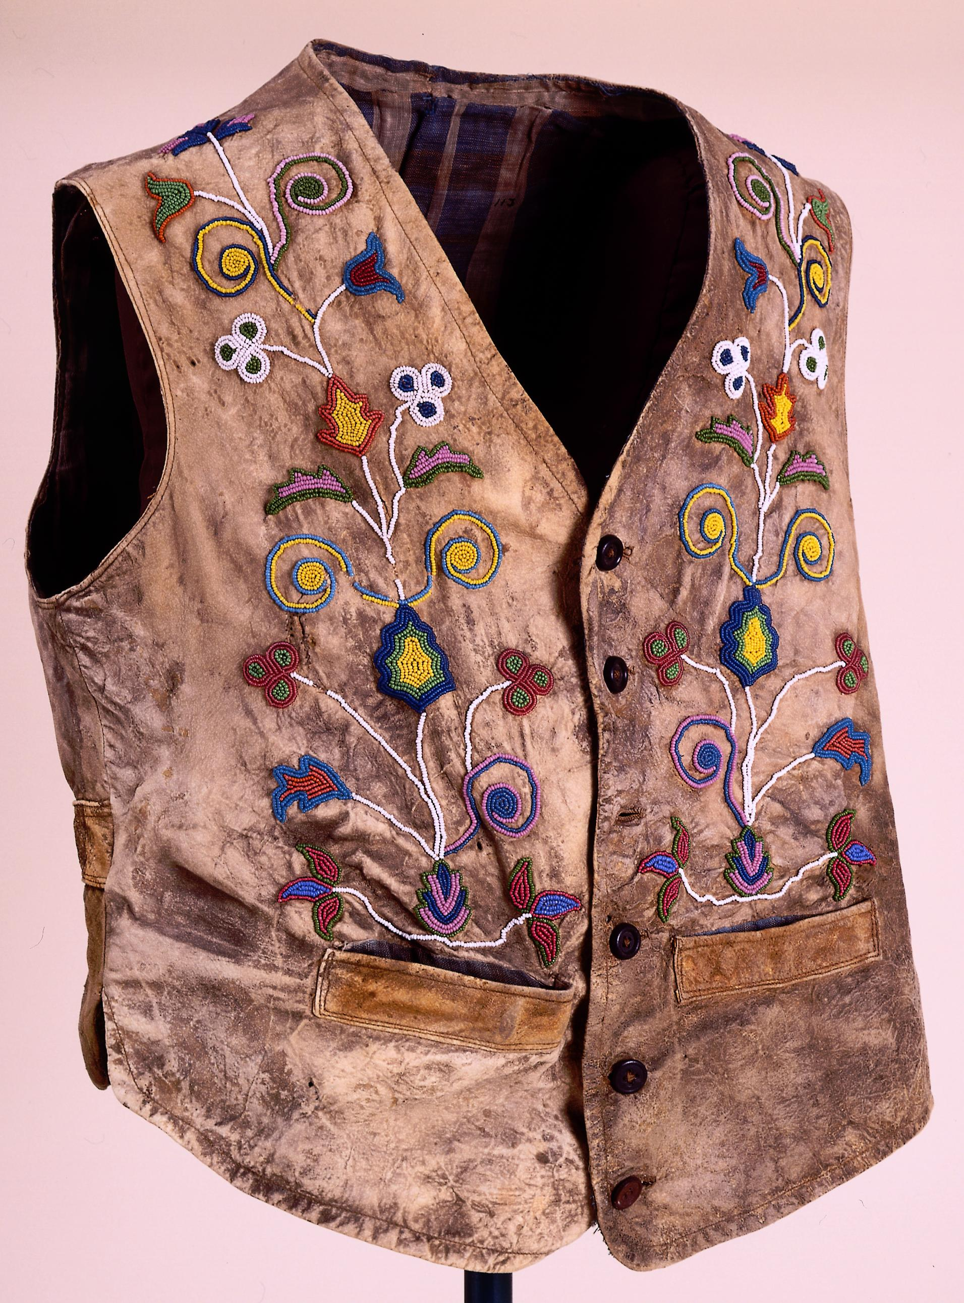
Crow-style vest (used by Calamity Jane and Frederic Remington), ca. 1880. Buckskin, buttons, and beads. 1.67.188

Slide 21
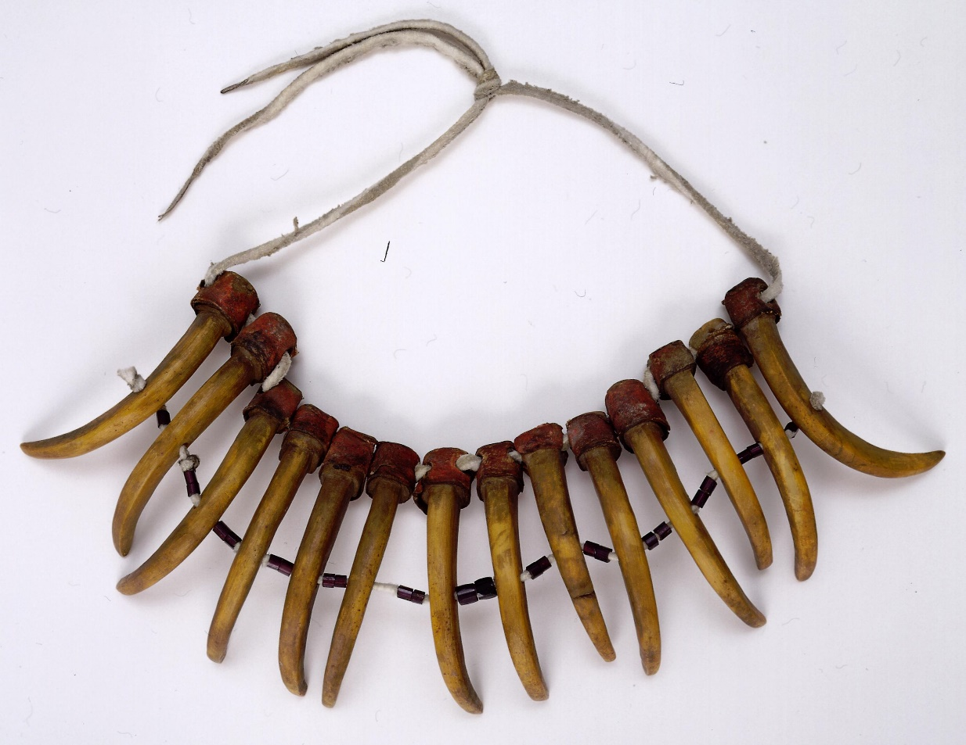
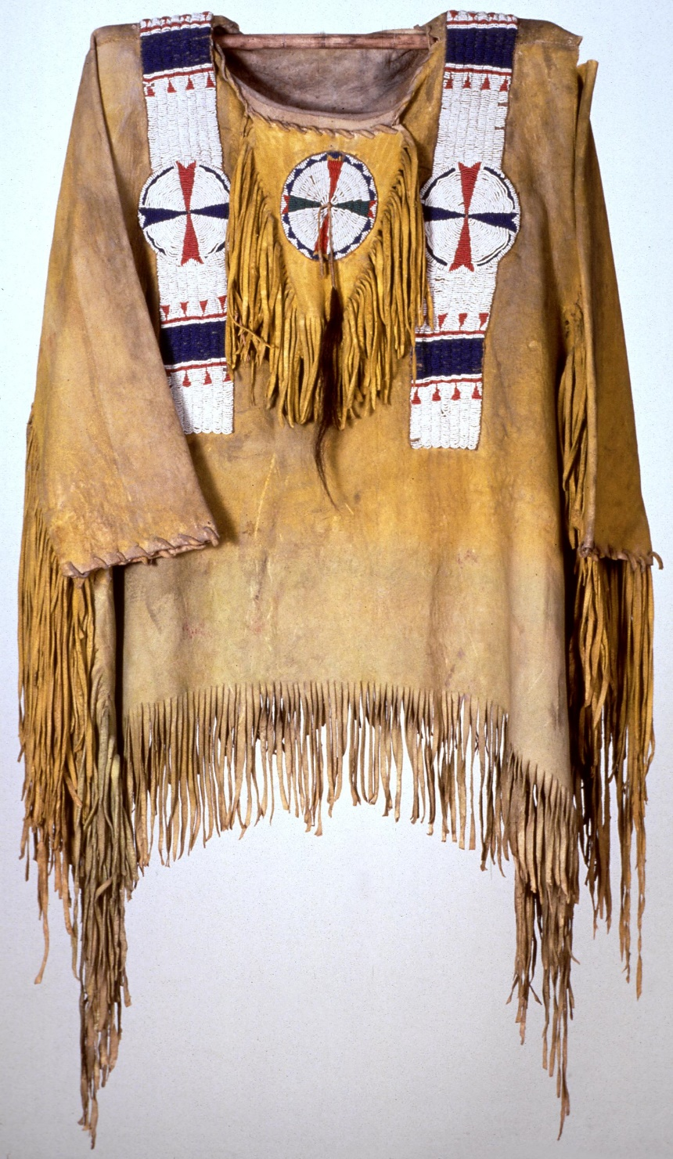
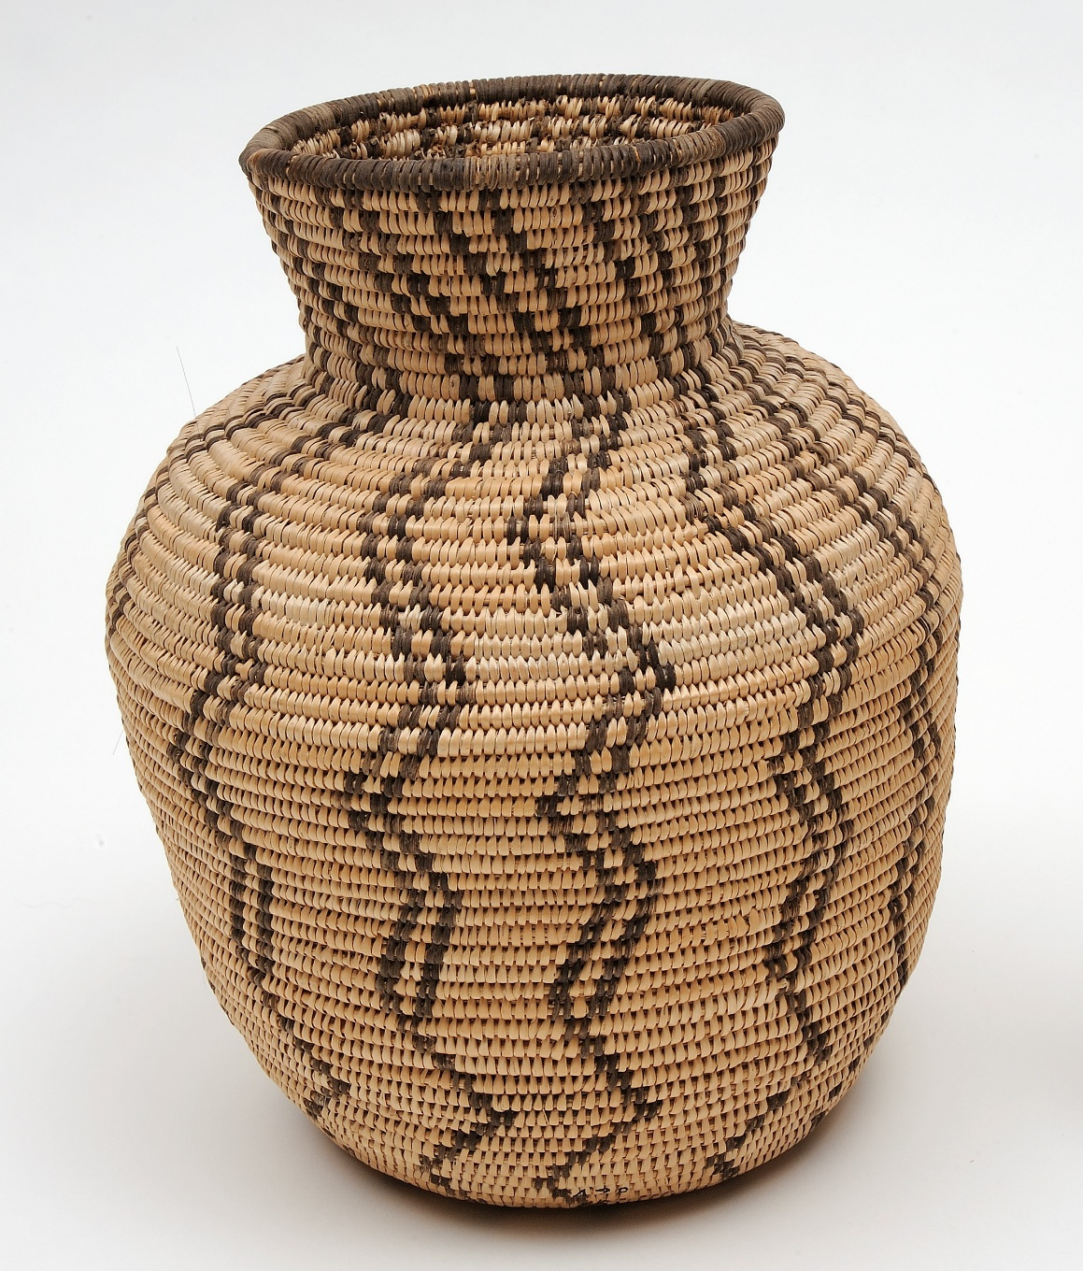
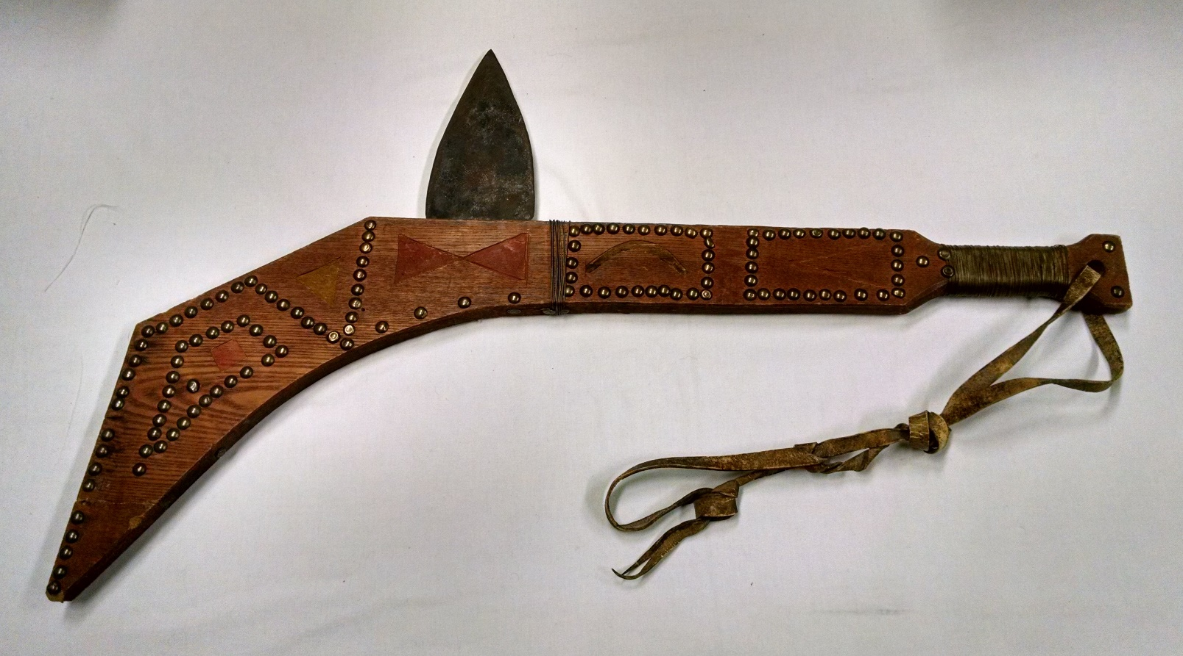
Bear Claw-Styled Necklace (Winnegabo)
Ca. 1880, 1.67.164
Olla Basket (Apache)
N.d., 1.67.164
Man’s War Shirt (Ute)
Ca. 1875, 1.67.112
Gunstock War Club (Sioux)
Ca. 1900, 1.67.386

Slide 22
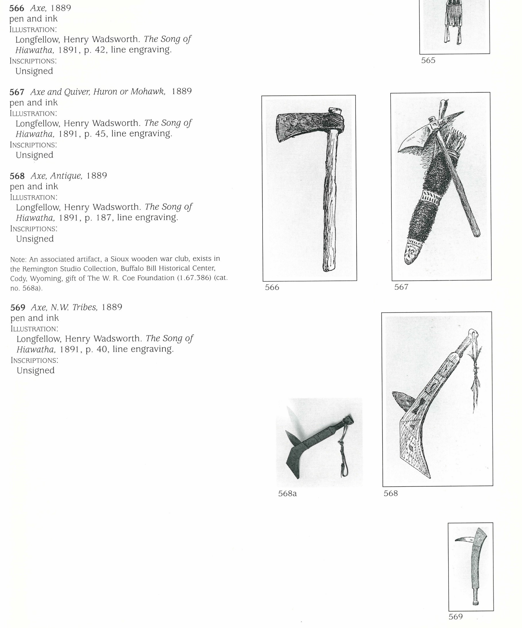
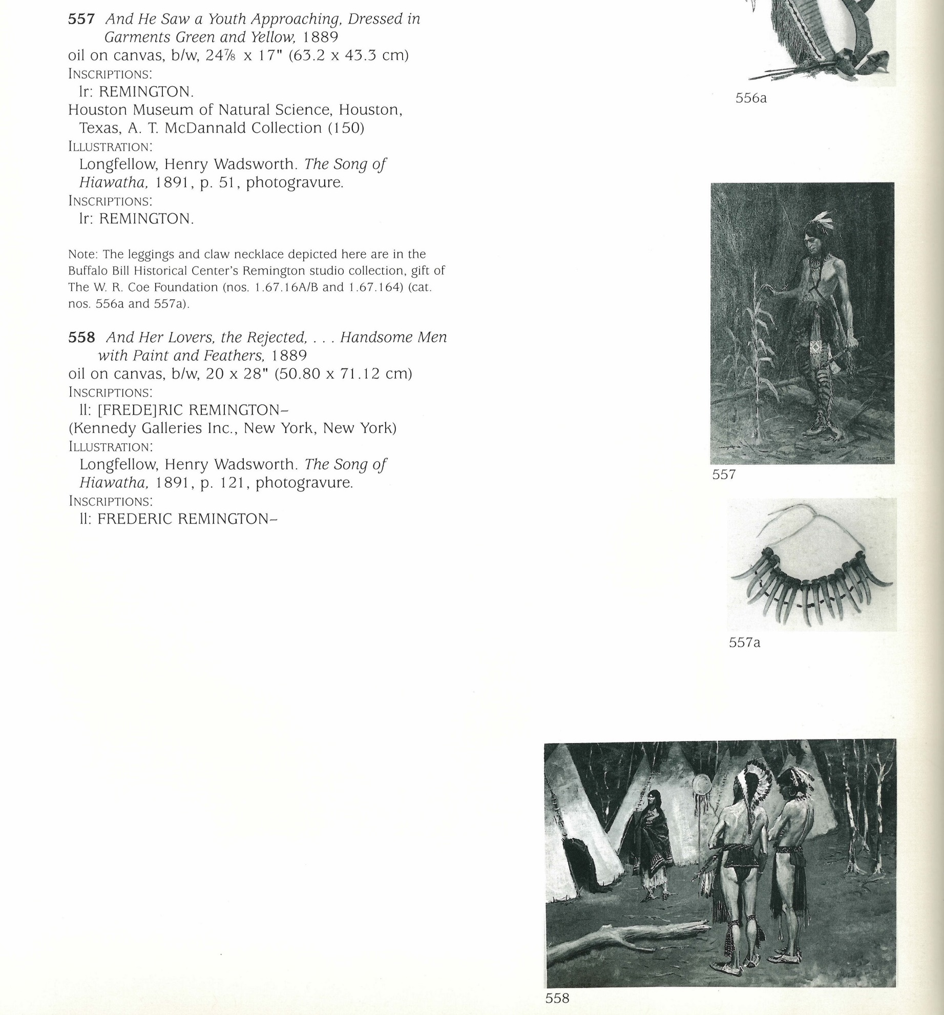

Slide 23
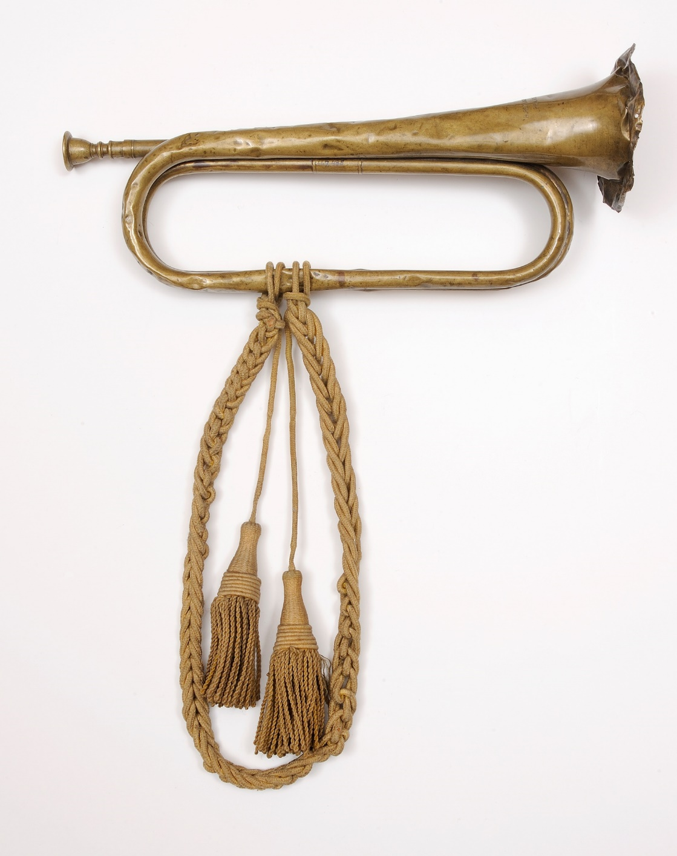
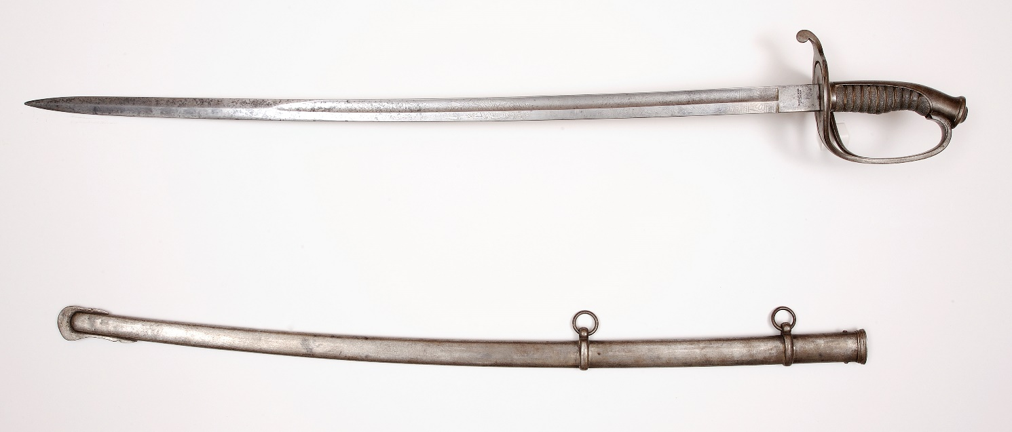
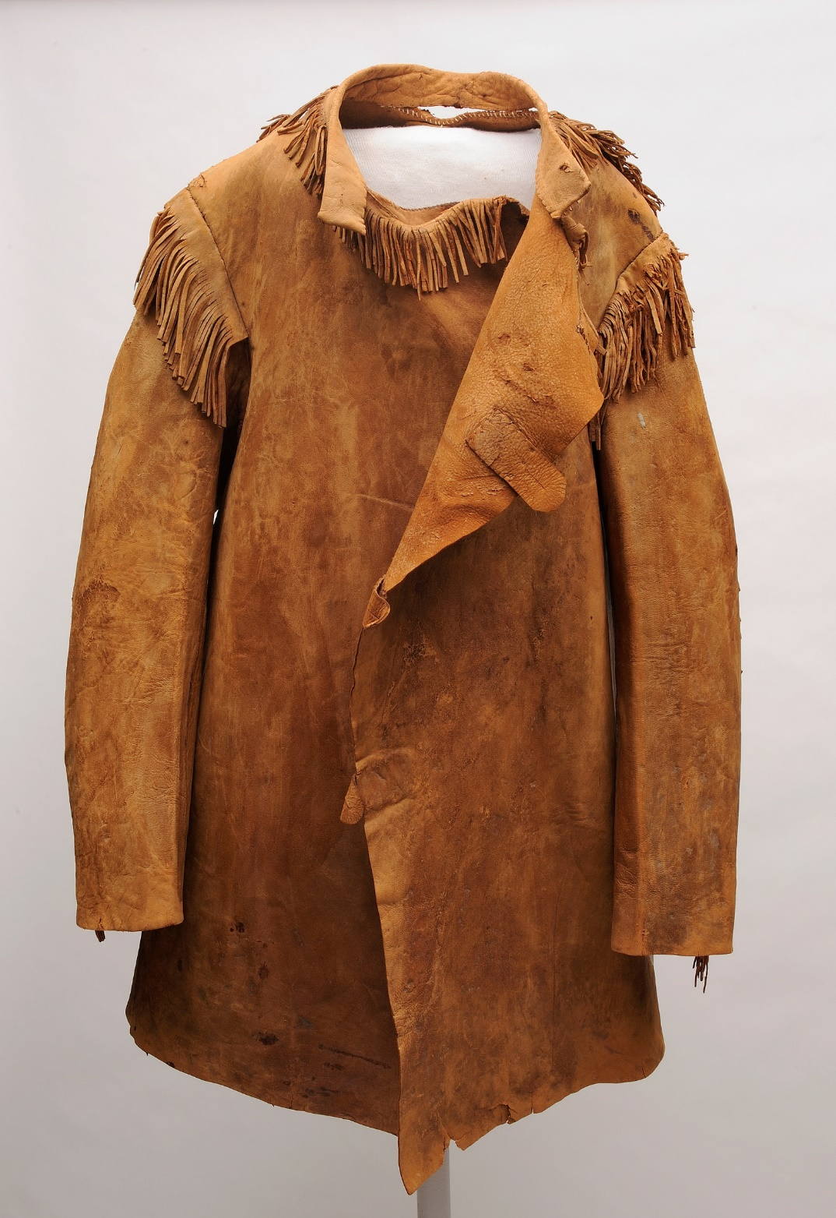
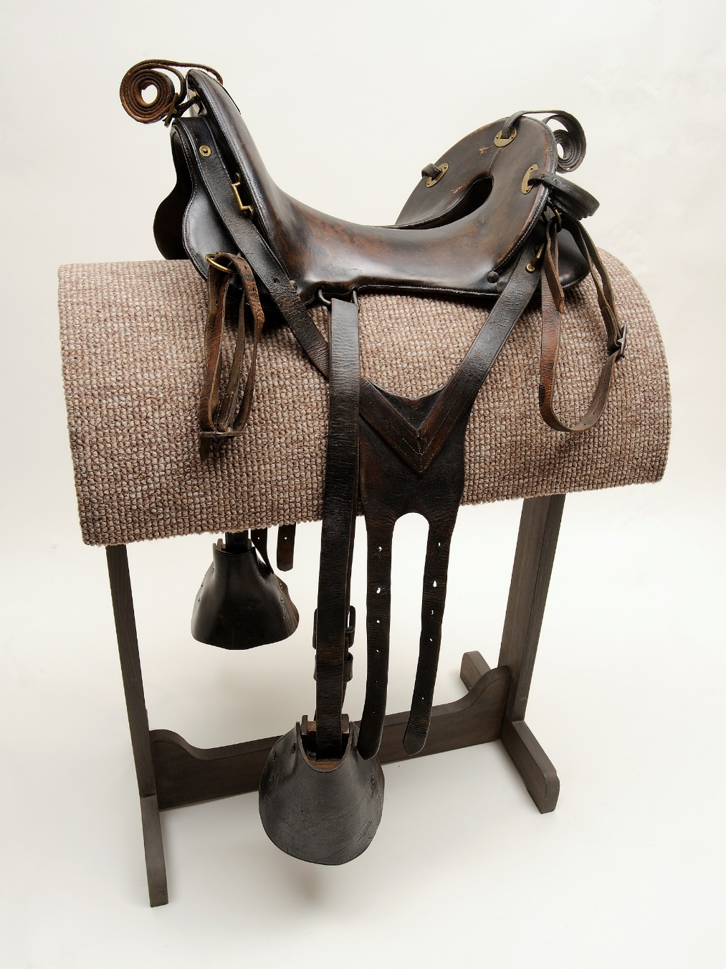
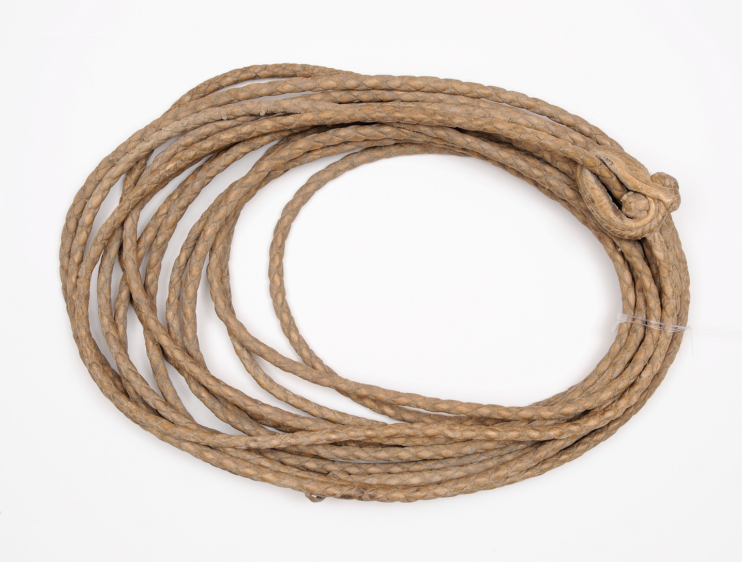
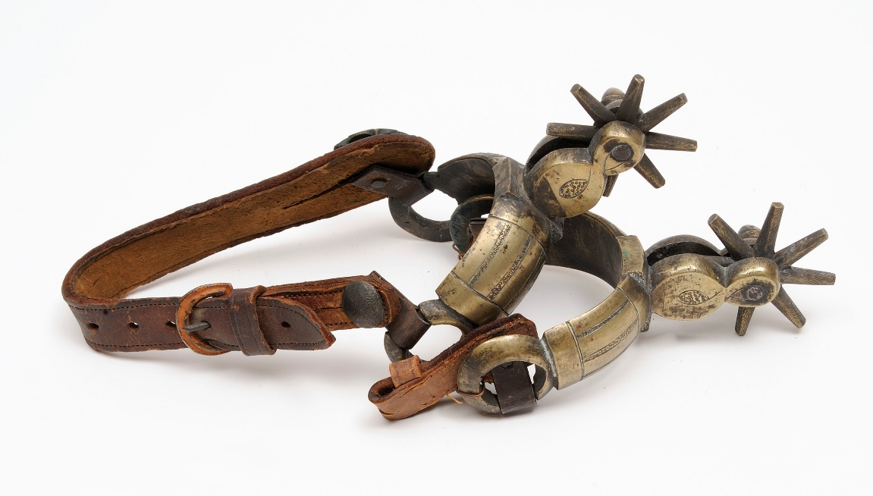
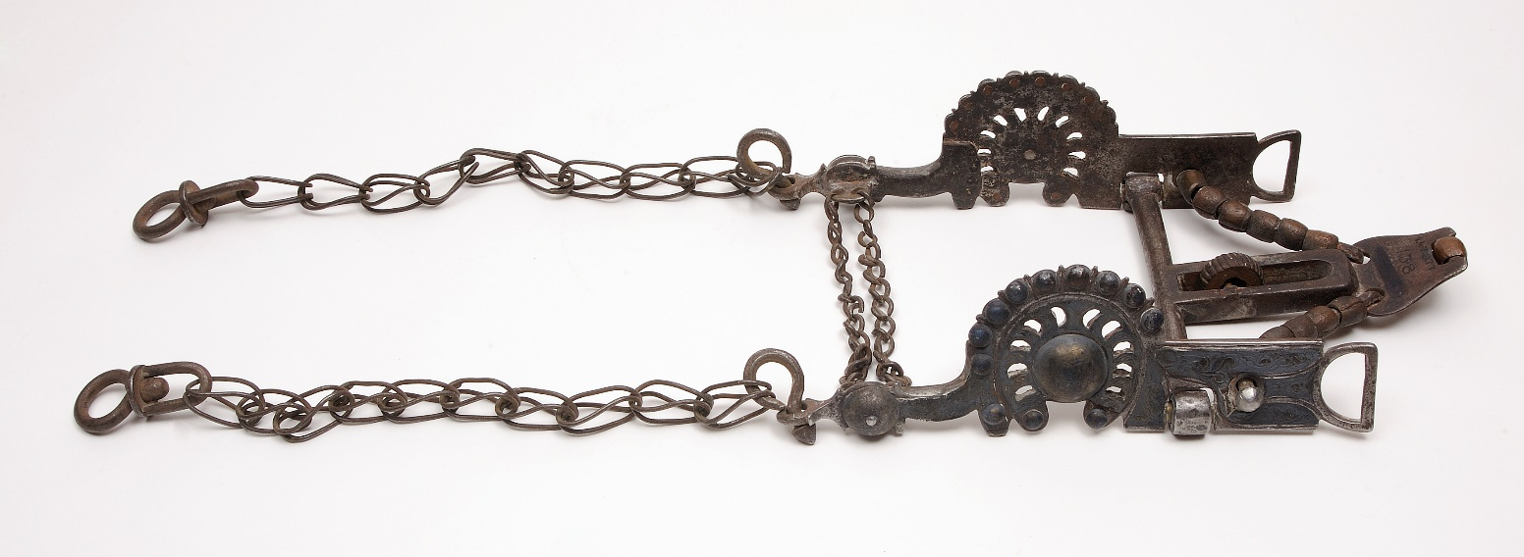

Slide 24
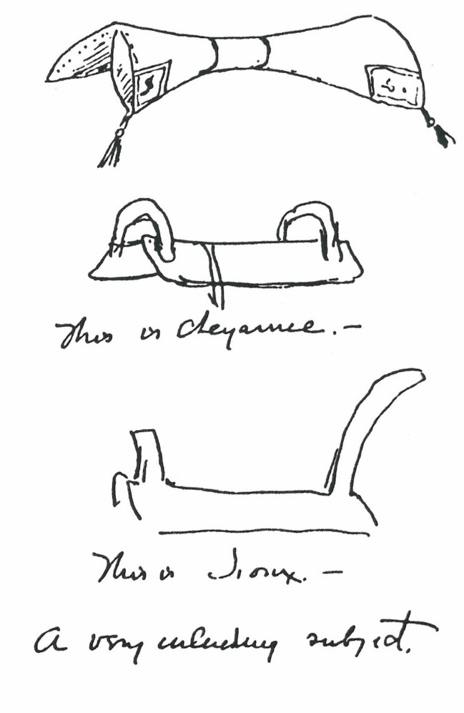
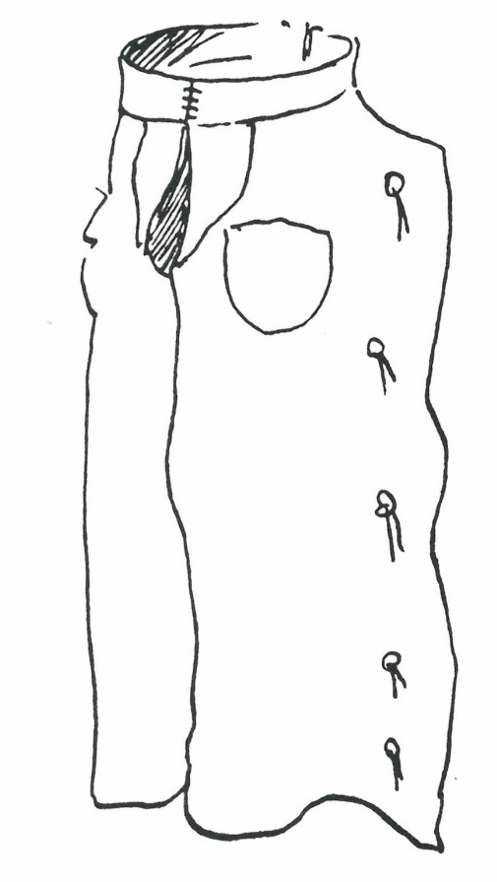
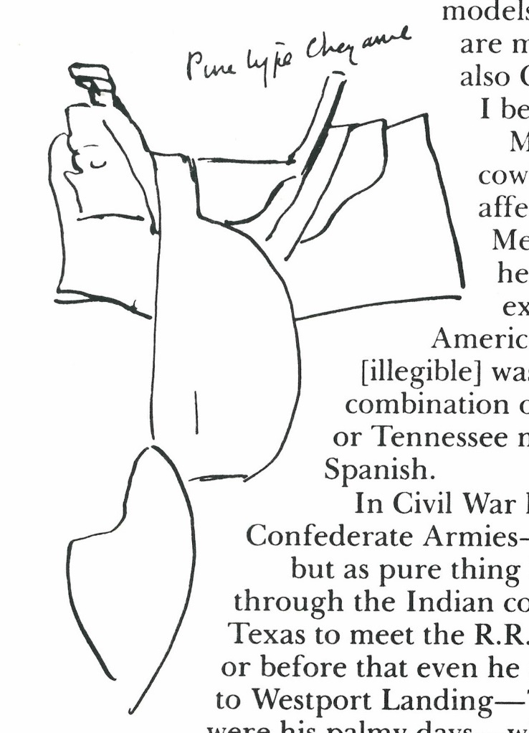

Slide 25
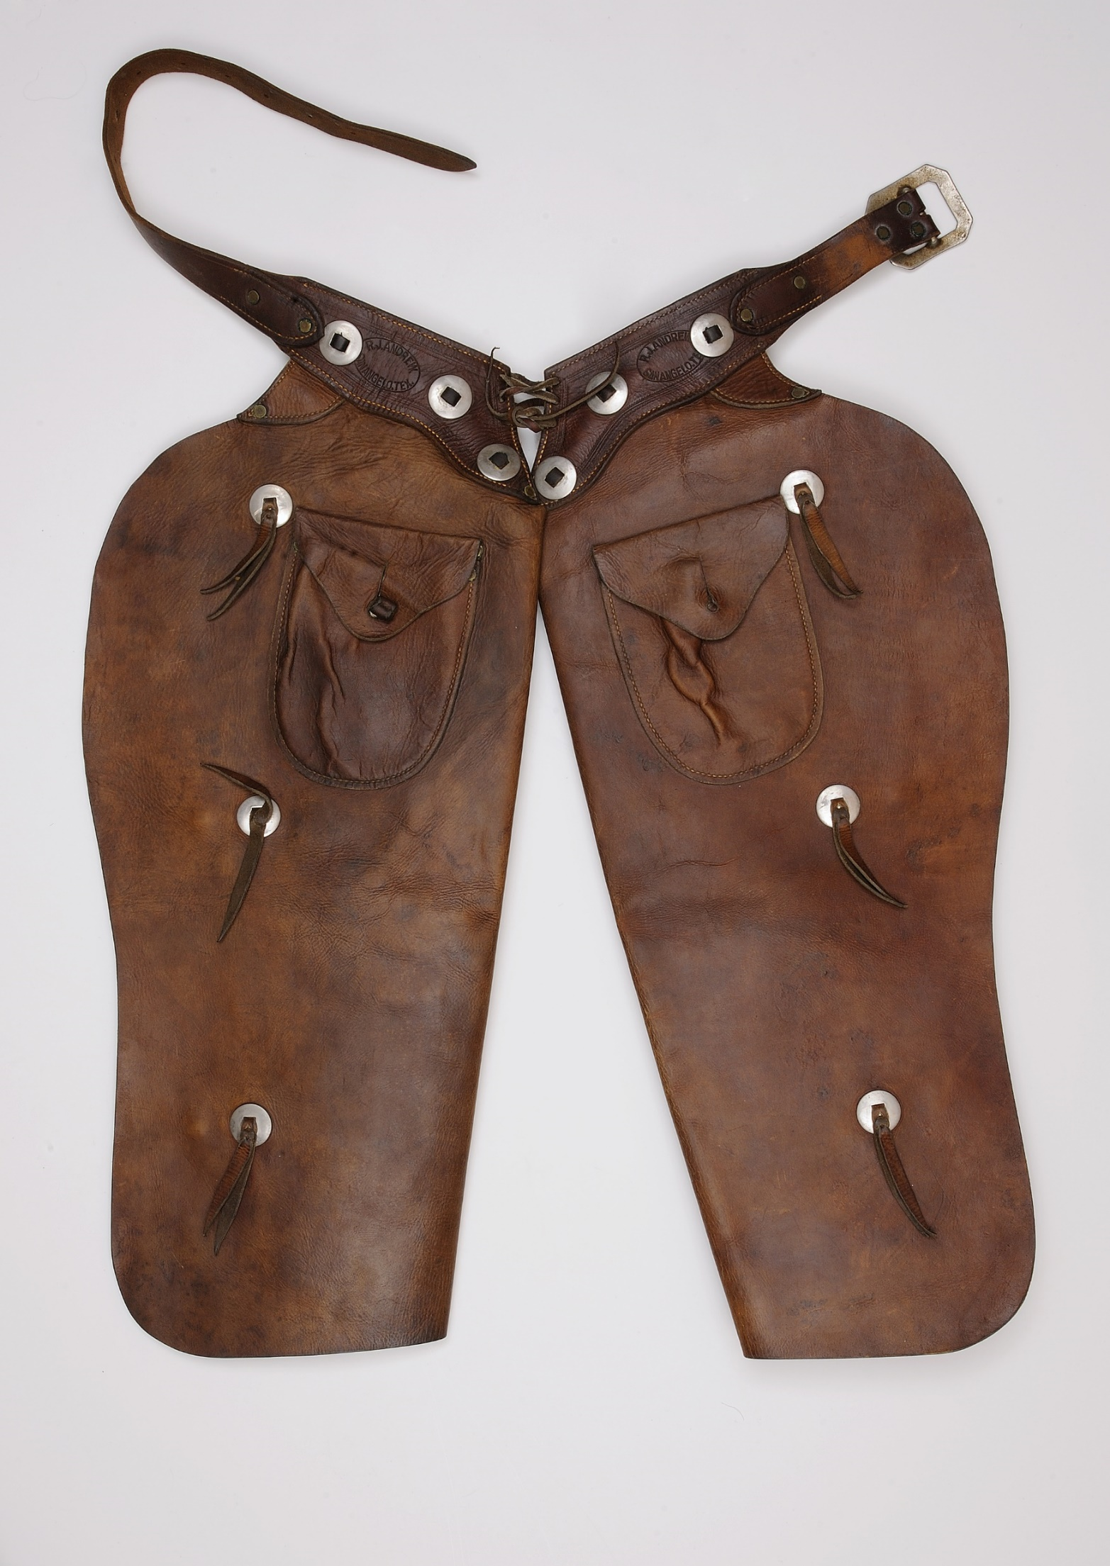
Remington, to friend
Lt. Powhatan Clarke, 1889:
“I have a big order for a cow-boy picture [A Dash for the Timber] and I want a lot of “chapperras” - say two or three pairs - and if you will buy them [off] some of the cow-boys there and ship them to me by express C.O.D. I will be your slave. I want old ones - and they should all be different in shape. …I have four pairs now and want some more.”

Slide 26
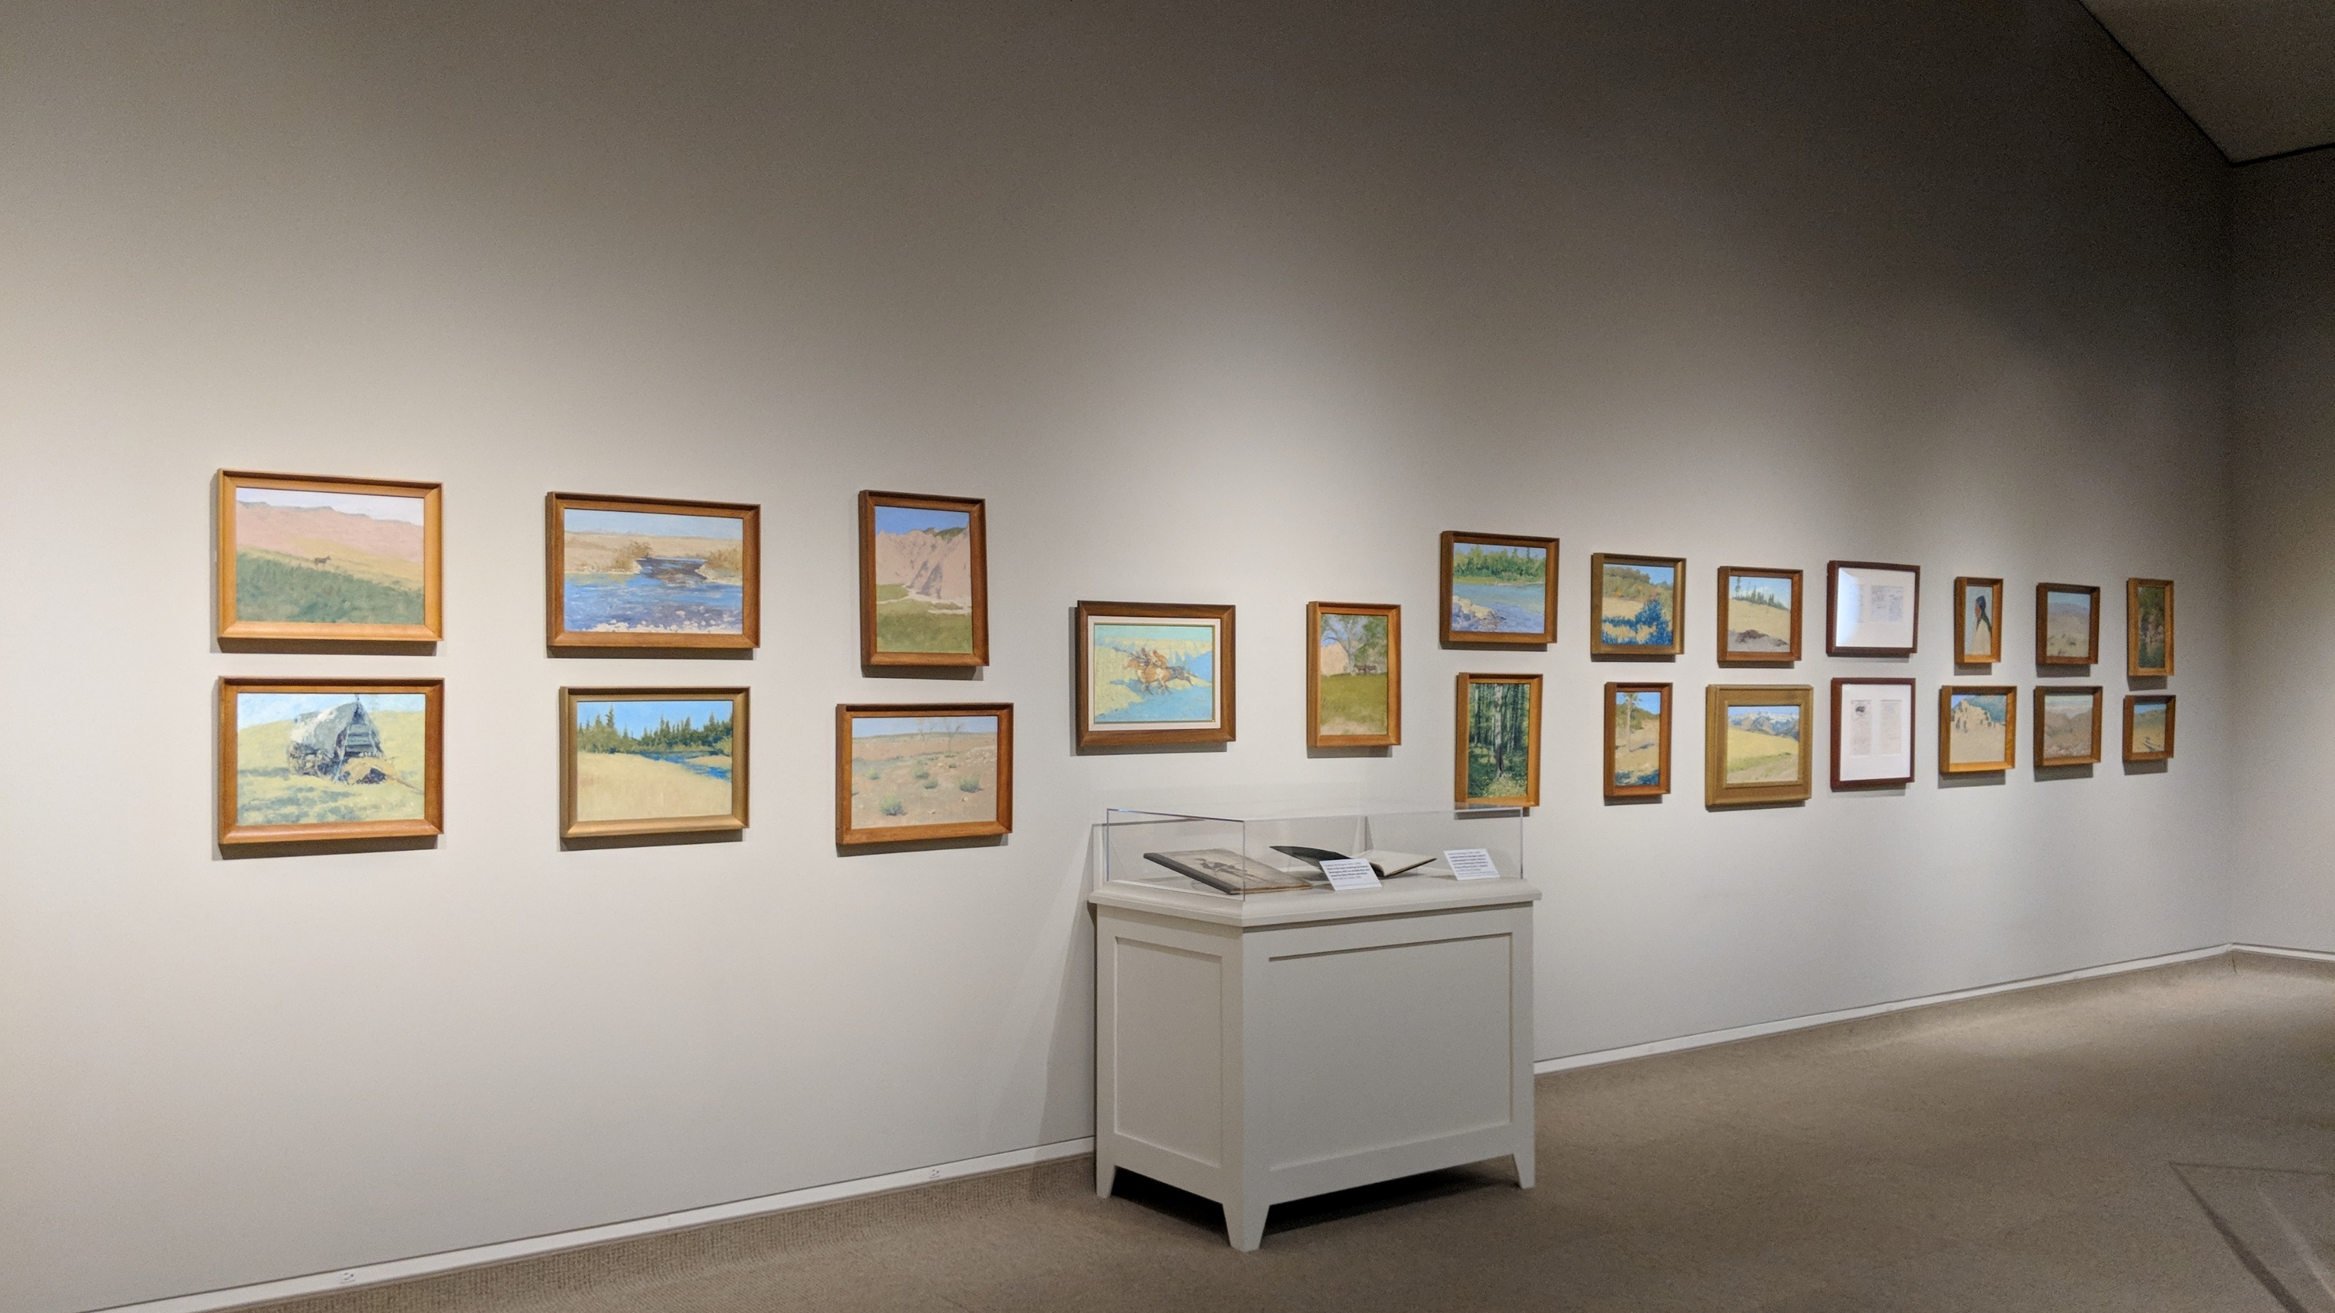

Slide 27
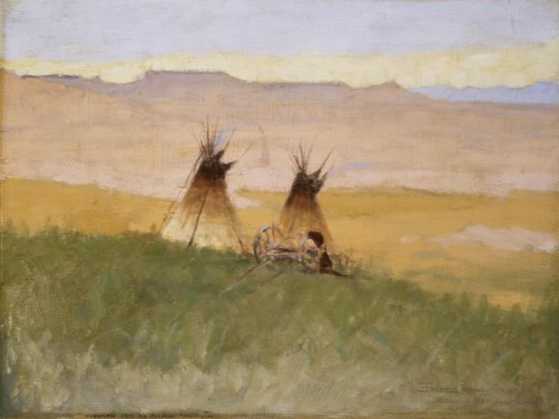
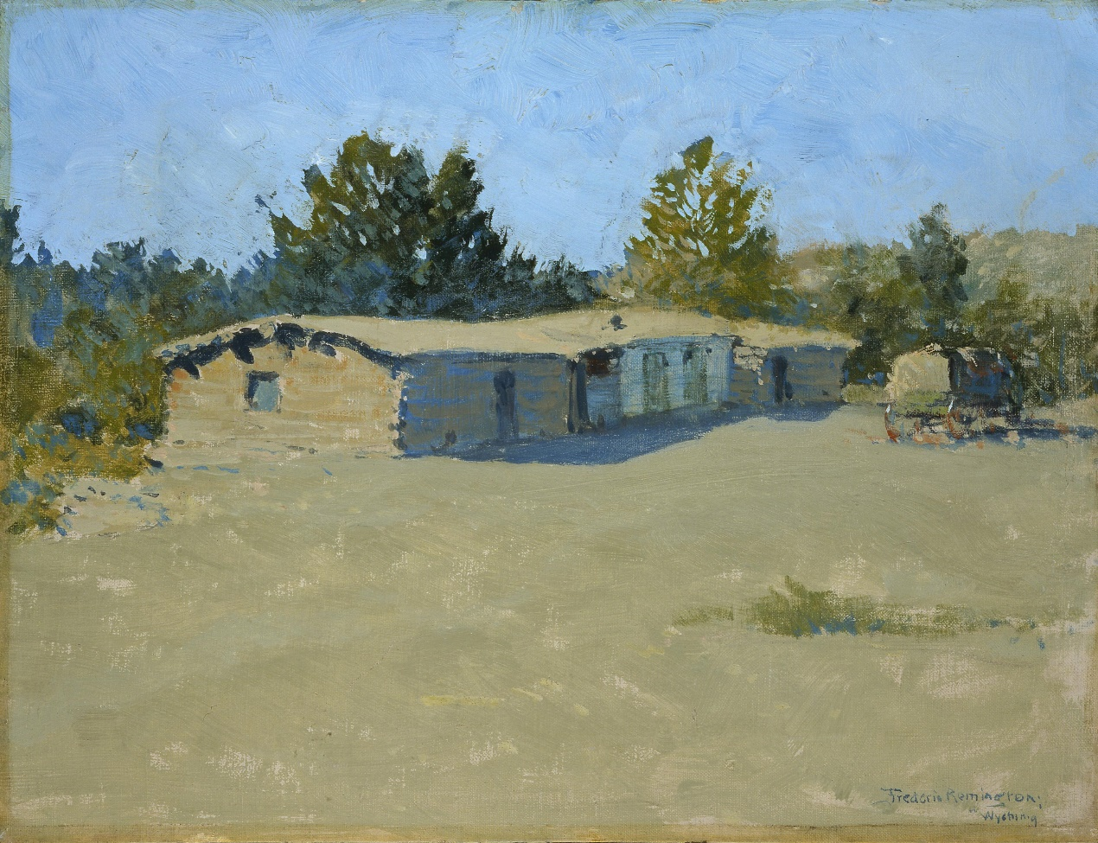
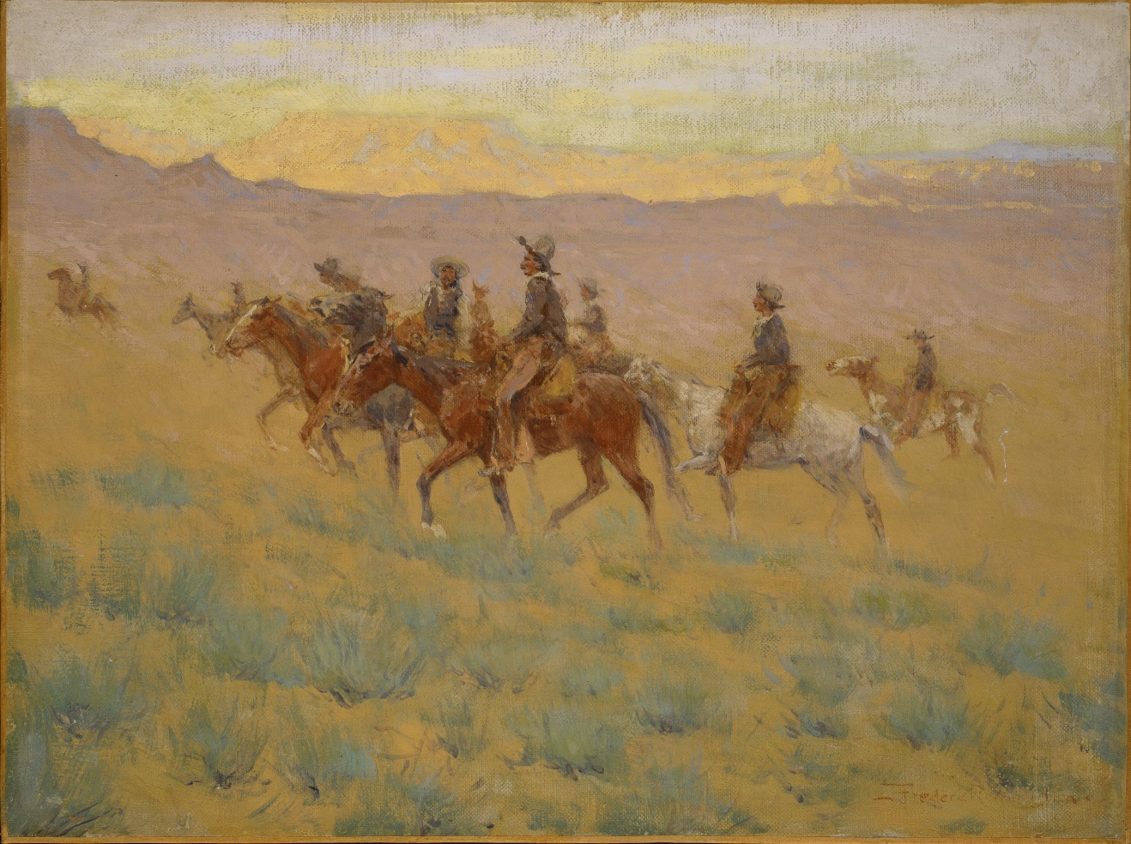
Stormy Morning in the Bad Lands
1906, oil on canvas. 40.67
Untitled (log ranch building with wagon [Wyoming])
1908, oil on board. 59.67
Ghosts of the Past
ca. 1908, oil on canvas. 60.67

Slide 28
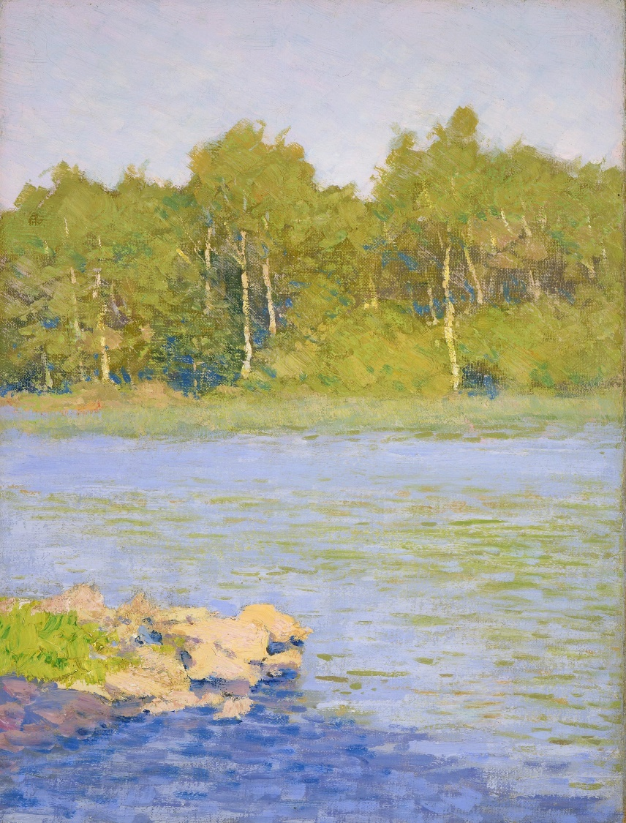
Clockwise from top left:
Lake and Quaken Aspen Trees in Back
N.d., oil on canvas. 18.67
Winter Sketch
N.d., oil on board. 79.67
Impressionistic Winter Scene
1908-1909, oil on board. 80.67
Impressionistic Winter Scene of New
England Farm Barn
N.d., oil on board. 82.67
Winter Scene of Snow-covered Log Cabin
N.d., oil on board. 78.67

Slide 29
Remington painting at Fort Robinson, Nebraska, 1905 (FRAM)

Slide 30
Photograph by Remington of water lilies, after 1901 (FRAM)
Frederic Remington, Radisson and Groseilliers
1905, oil on canvas. Gift of Mrs. Karl Frank. 14.86

Slide 31
Photograph by Remington of water lilies, after 1901 (FRAM)
Frederic Remington, Untitled (Eva Remington, Chippewa Bay)
N.d, oil on board. 99.67

Slide 32
Photograph by Remington of water lilies, after 1901 (FRAM)
Untitled (Impressionistic scene), N.d, oil on board. 88.67

Slide 33
Ogdensburg Public Library
Parish Mansion, home of the Frederic Remington Art Museum

Slide 34
The Remington Studio Collection installed at the Whitney Gallery of Western Art, 1959

Slide 35
Peter Hassrick, 1981
The Remington Studio Collection re-installed at the Whitney Gallery of Western Art, 1981

Slide 37
Joseph Henry Sharp’s “Absarokee Hut” (cabin from Crow Agency)

Slide 38
The W.H.D. Koerner Studio Collection

Slide 39
The Alexander Phimister Proctor Studio

Slide 40
Remington at Buffalo Bill Cody’s Wild West

Slide 41
Calhoun Printing Company, Hartford, CT, Besieged Cowboys, 1885. Woodblock on paper. Museum Purchase. 1.69.6148

Slide 42
Frederic Remington, Buffalo Bill in the Limelight, ca.1899. Oil on canvas.
Gift of The Coe Foundation, H.P. Skoglund, Ernest Goppert, Sr. and John S. Bugas. 23.71

Slide 43
Frederic Remington, Hiding the Trail, ca.1899. Oil on canvas. Mary Jester Allen Collection. 114.67

Slide 44
Frederic Remington, The Big Things (At the Cody Ball)
1899. Pen and ink on paper. Museum Purchase. 78.69

Slide 45
Frederic Remington, Unhaltered Pack Horse, 1899. Oil on canvas. Gift in fond memory of our dear parents, from their devoted sons Dr. Peter Kooi Simpson and Sen. Alan Kooi Simpson. 21.98.1

Slide 46
Frederic Remington, A Post Office in the "Cow Country,” ca. 1901. Oil on canvas. Museum Purchase. 11.76

Slide 47
Remington painting in Wyoming, 1908, his last trip west (FRAM)
Remington’s A Bunch of Buckskins
at Buffalo Bill’s Irma Hotel

